Slide 1
Chhatrapati Shivaji Terminus
Integrative studio and seminar project
FYS F

Slide 2
MEMBERS-
DIPANNITA CHOWDHURY
FENA MAHESHWARI
HARSH PATEL
KHUSHI GALA
RASILA BERA

Slide 3
Introduction to CST
Chhatrapati shivaji terminus formerly known as Victoria terminus is a historical terminal train station in the city of Mumbai, Maharashtra.
It is also recognised by the UNESCO as a world heritage site. It was designed by a British architectural engineer Fredrick William Stevens.
The terminus was designed and built by Britishers and was designed in the style of Victorian Italianate gothic revival architecture. The construction began in 1878 and was completed in 1887, the building marked 50 years of queen Victoria’s rule.
The station’s name was changed to Chhatrapati Shivaji terminus in march 1996 to honour shivaji, the founder of the Maratha empire in the 17th century.
CST or CSMT is one of the busiest railway station’s in India, serving as a terminal for both suburban and long distance trains.

Slide 4
Interview questionnaire
Name?
Occupation?
How long have you been working here for?
What are the kind of changes you’ve noticed over the years? Is it good or bad? Have you benefitted from these changes?
Which time is better? The past or the present?
Would you like to see any changes in the future?

Slide 5
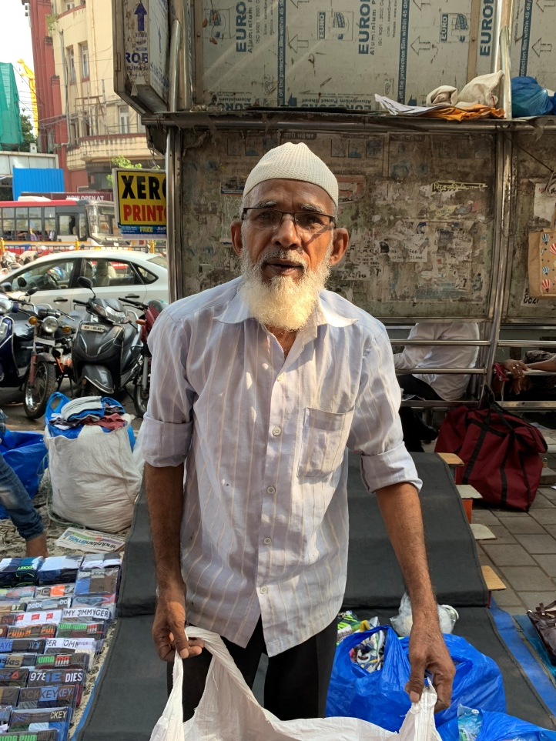
Interview 1
Name- Abdul Bahari
Occupation- Shoe seller
I’ve been working here since 1973
“Over the years everything has changed, there’s a lot of traffic, the number of cars have increased, it is difficult to even walk, the area is very crowded. I’ve seen everything come up right in front of my eyes, the new buildings, the station and the bustle. The change has benefitted me, I earn more now than I used to back in the day”.
“Both the past and the present are good but I prefer the present and would like to see what’s ahead of me”.
“The only change that matters to me is the education of my children in the future, my son is going to college soon”.

Slide 6
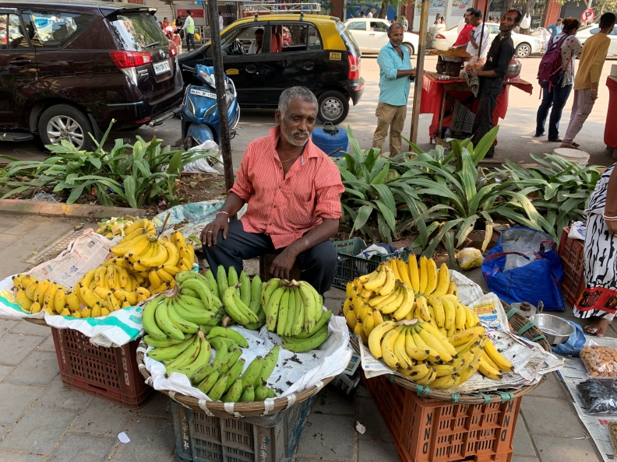
Interview 2
Name- Nagu Babu Johre
Occupation- Banana seller
I’ve been working for the past 20 years.
I've noticed a lot of change over the year, there are so many cars, buildings now, there was nothing here before, the area has changed a lot. I think the change is better. In the past 20 years, the flow of money has been constant, I’ve been selling bananas here for the past 20 years and I earn enough to survive.
Thinking about the future is not the luxury that I have, I stay sick for long periods of time, I work for 1 month and then I’m sick for the next. For the future I think there install AC’s in local trains, so that people can travel in comfort.

Slide 7
PLACES WE VISITED
For our project we travelled in and around the CST station, all places come within 5 km radius of the station.
CST station
Azad maidan
St. Thomas cathedral
Flora fountain
Horniman Circle
Marine drive

Slide 8
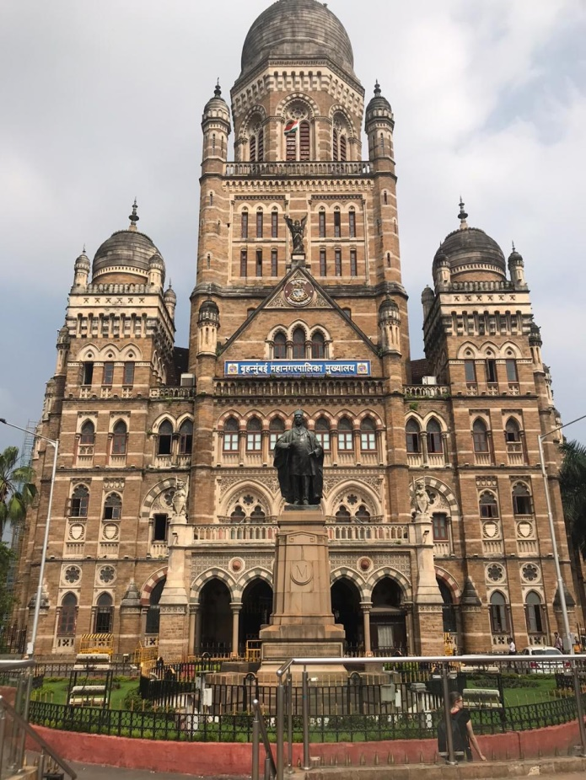
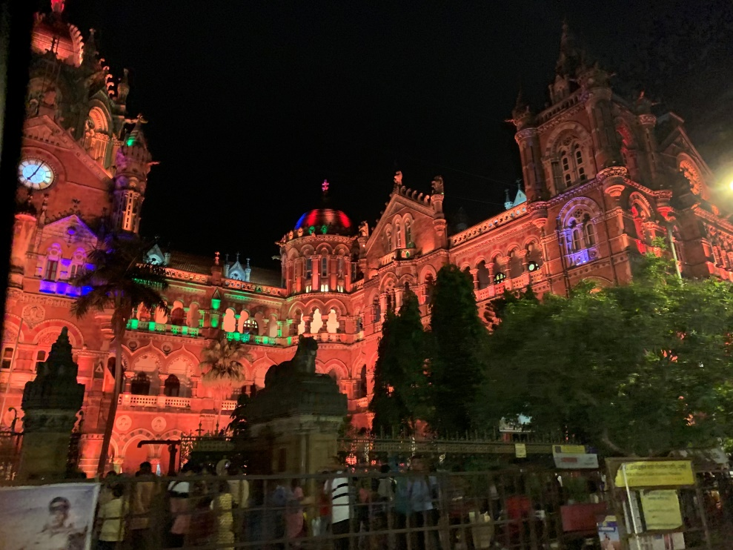
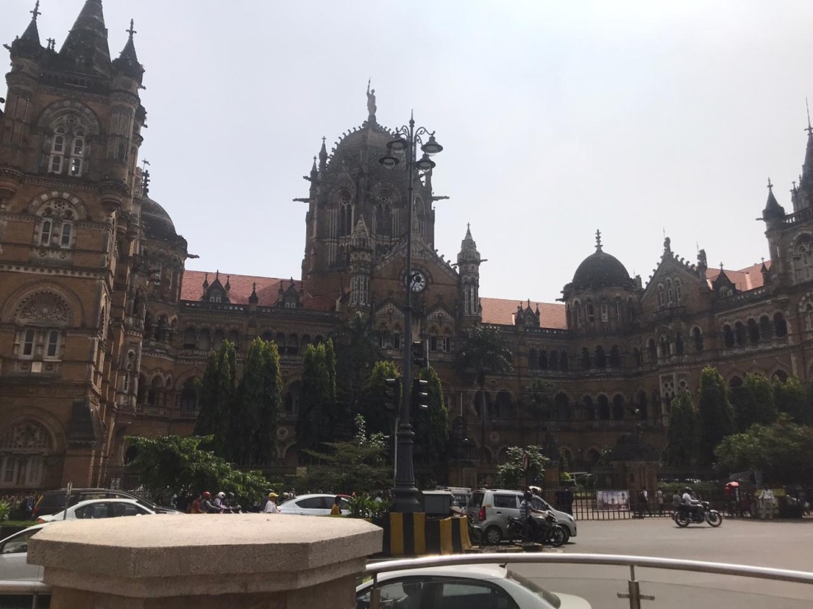
CST STATION

Slide 9
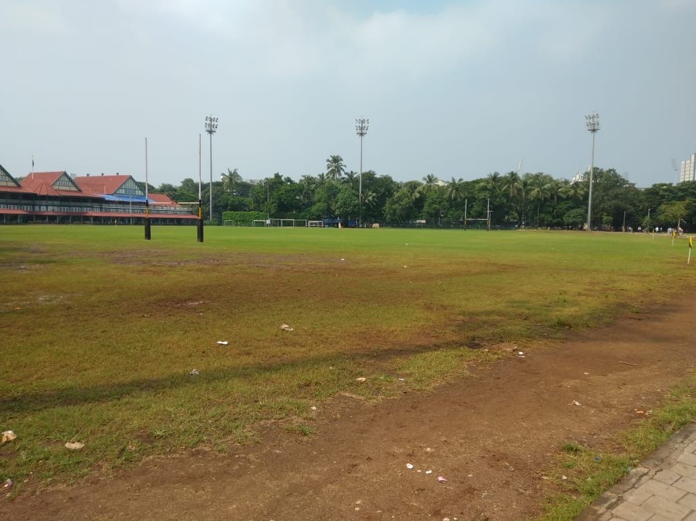
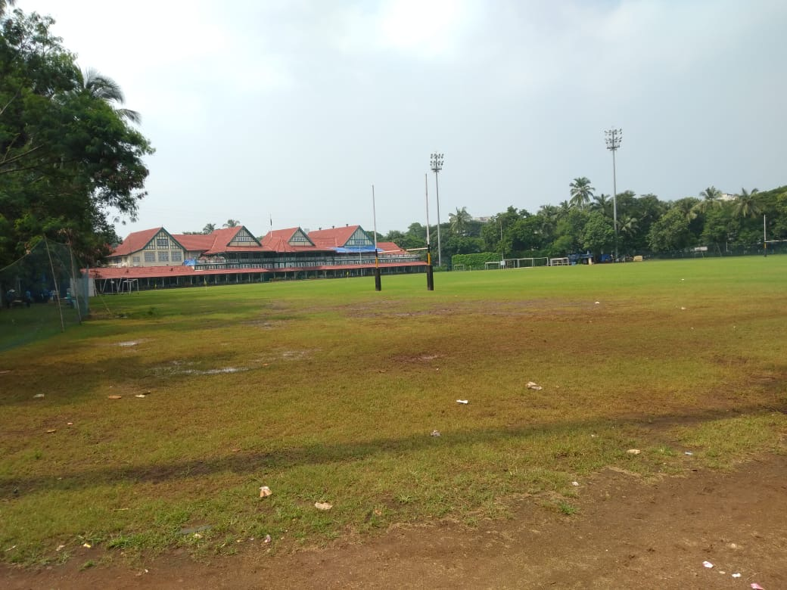
AZAD MAIDAN

Slide 10
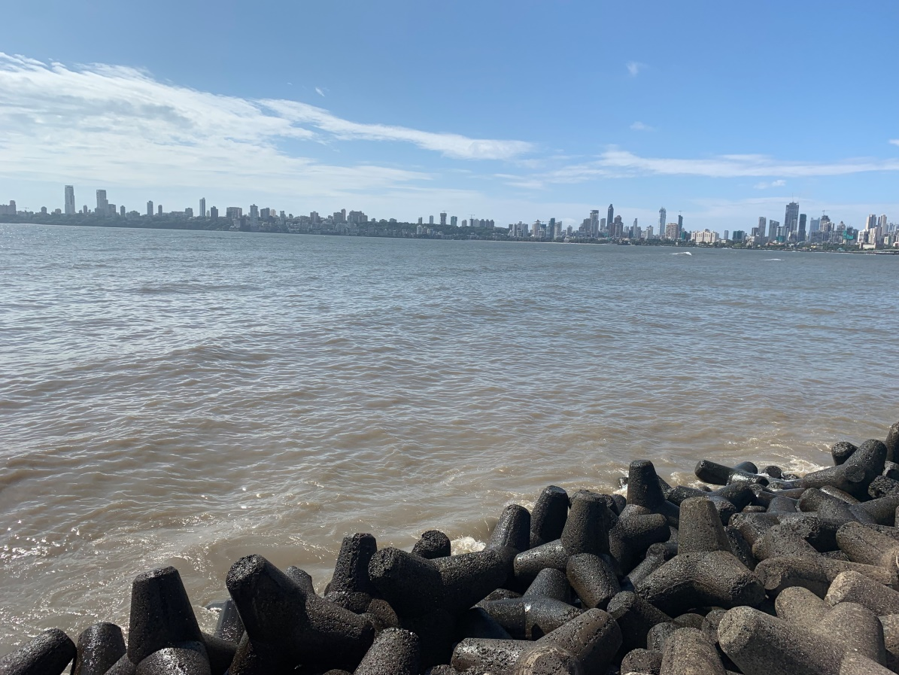
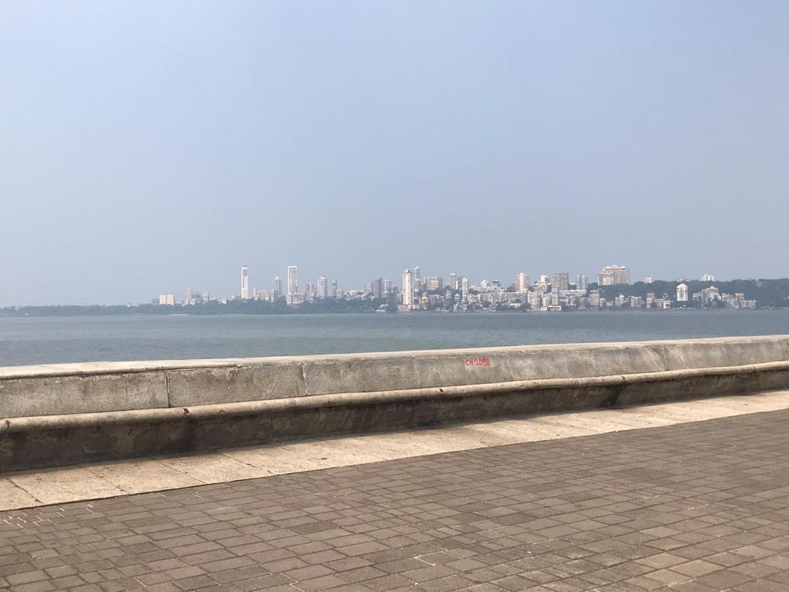
MARINE DRIVE

Slide 11
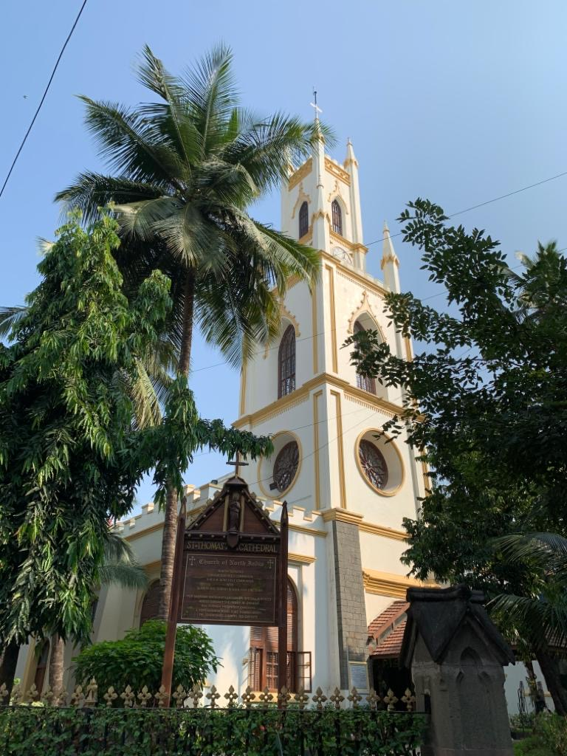
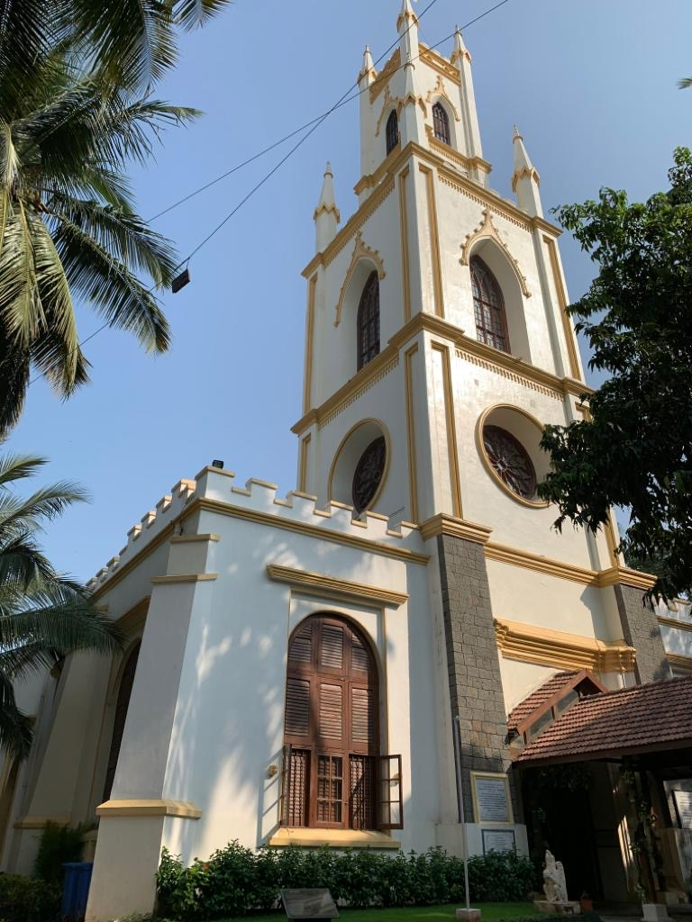
ST. THOMAS CATHEDRAL

Slide 12
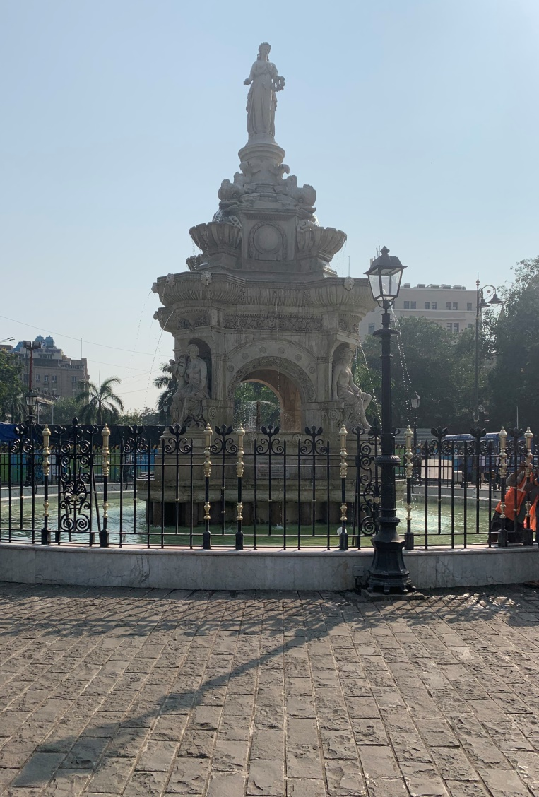
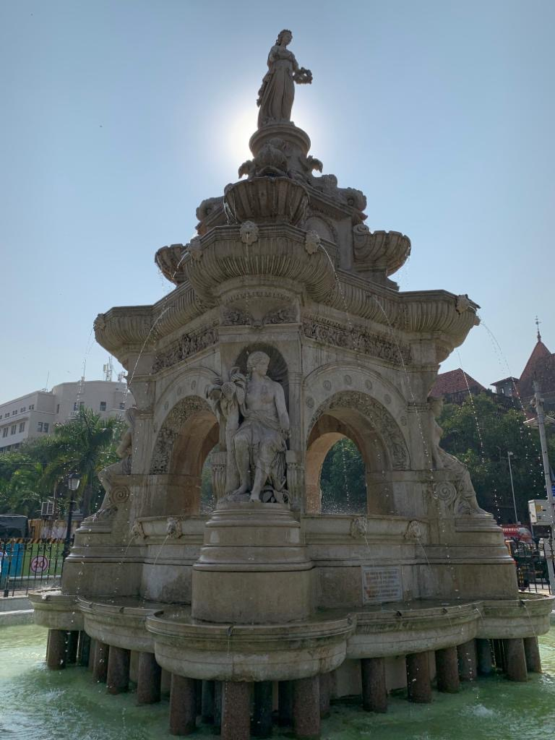
FLORA FOUNTAIN

Slide 13
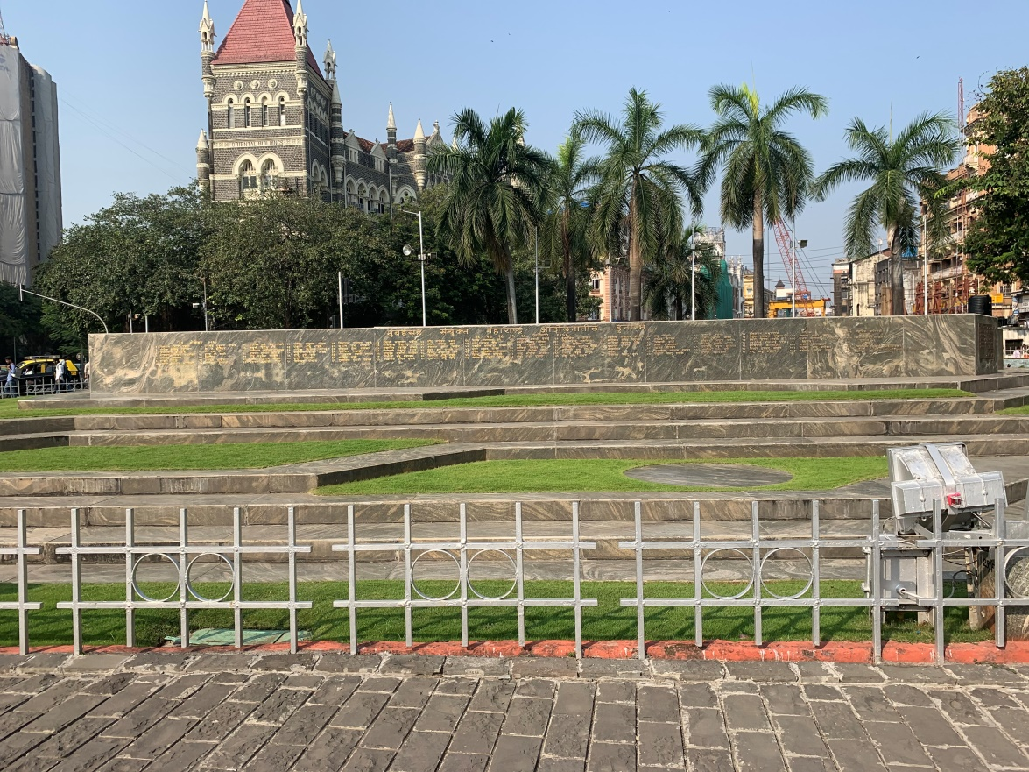
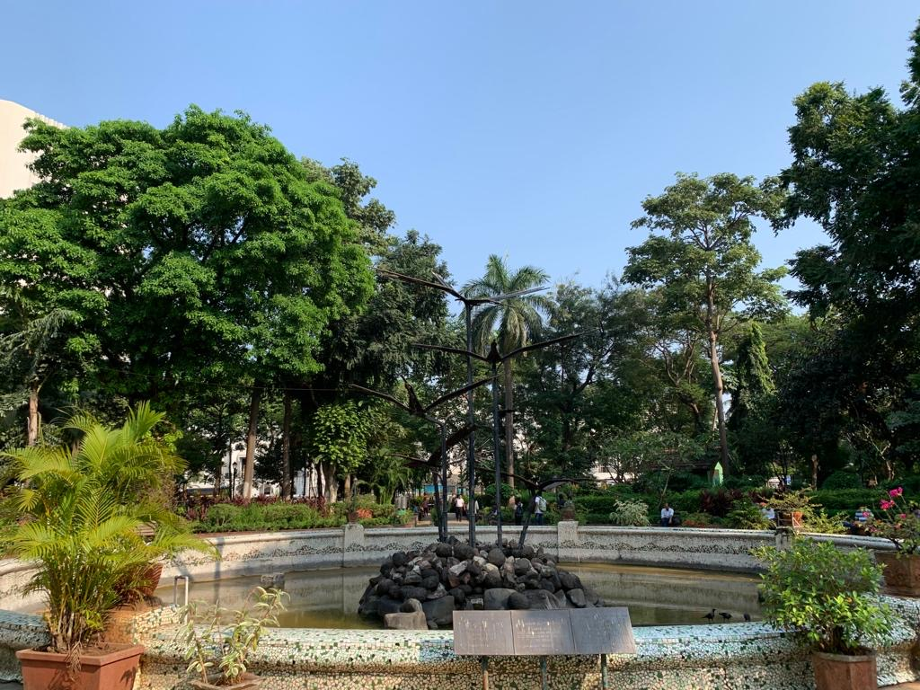
HORNIMAN CIRCLE

Slide 14
SKETCHES

Slide 15
ANT’S EYE VIEW

Slide 16
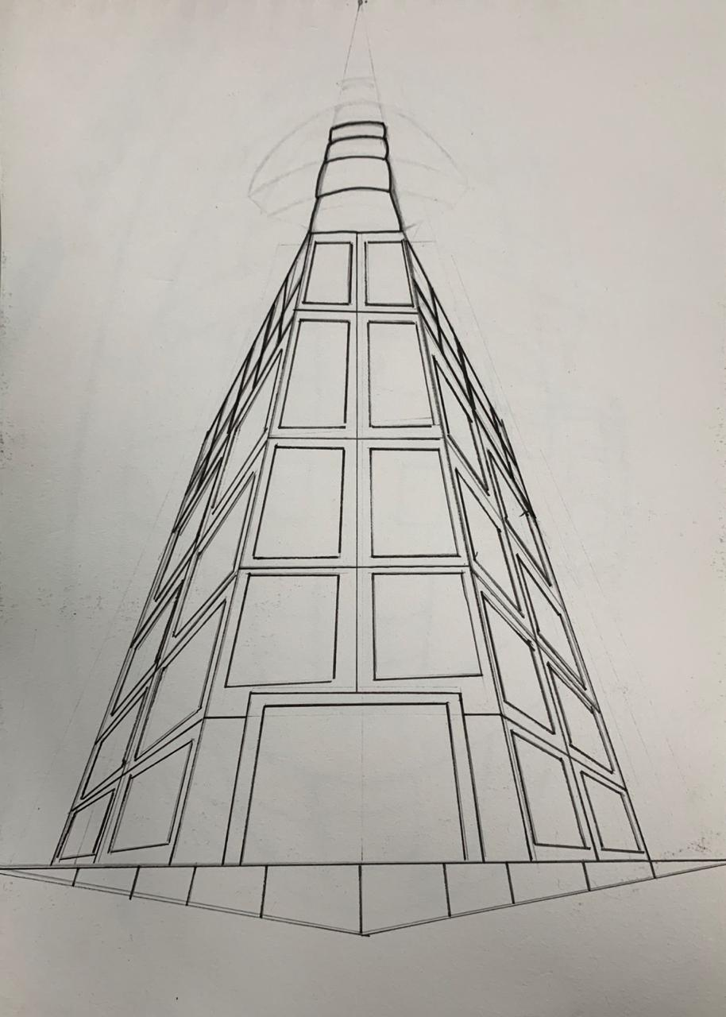
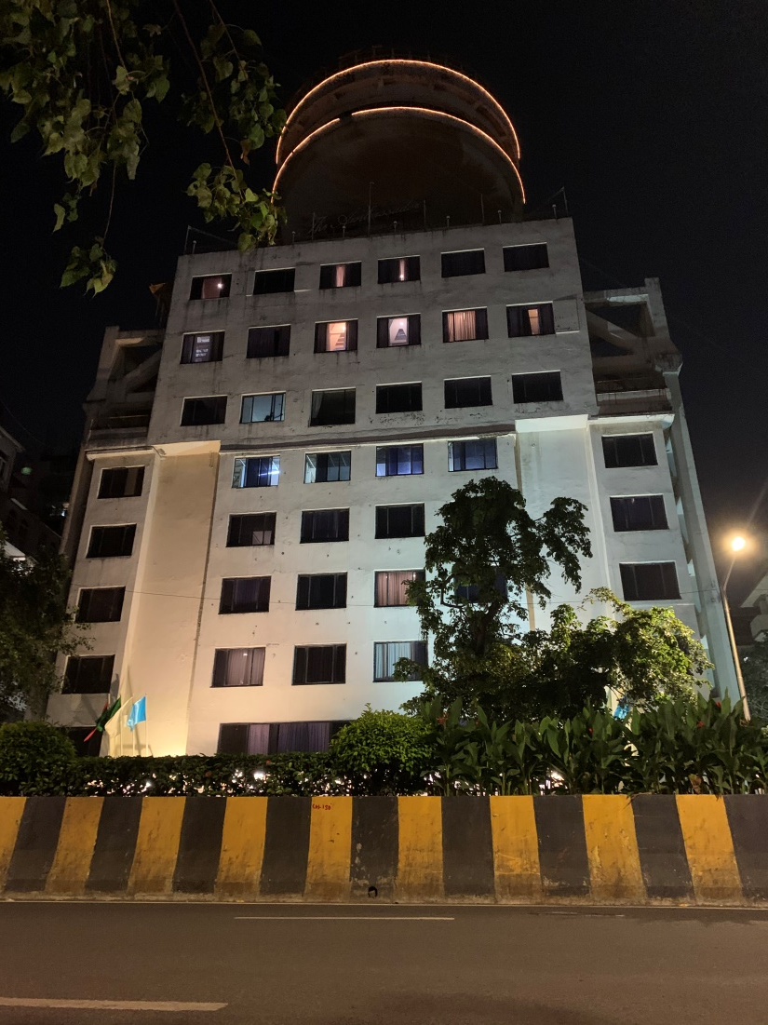
DIPANNITA CHOWDHURY

Slide 17
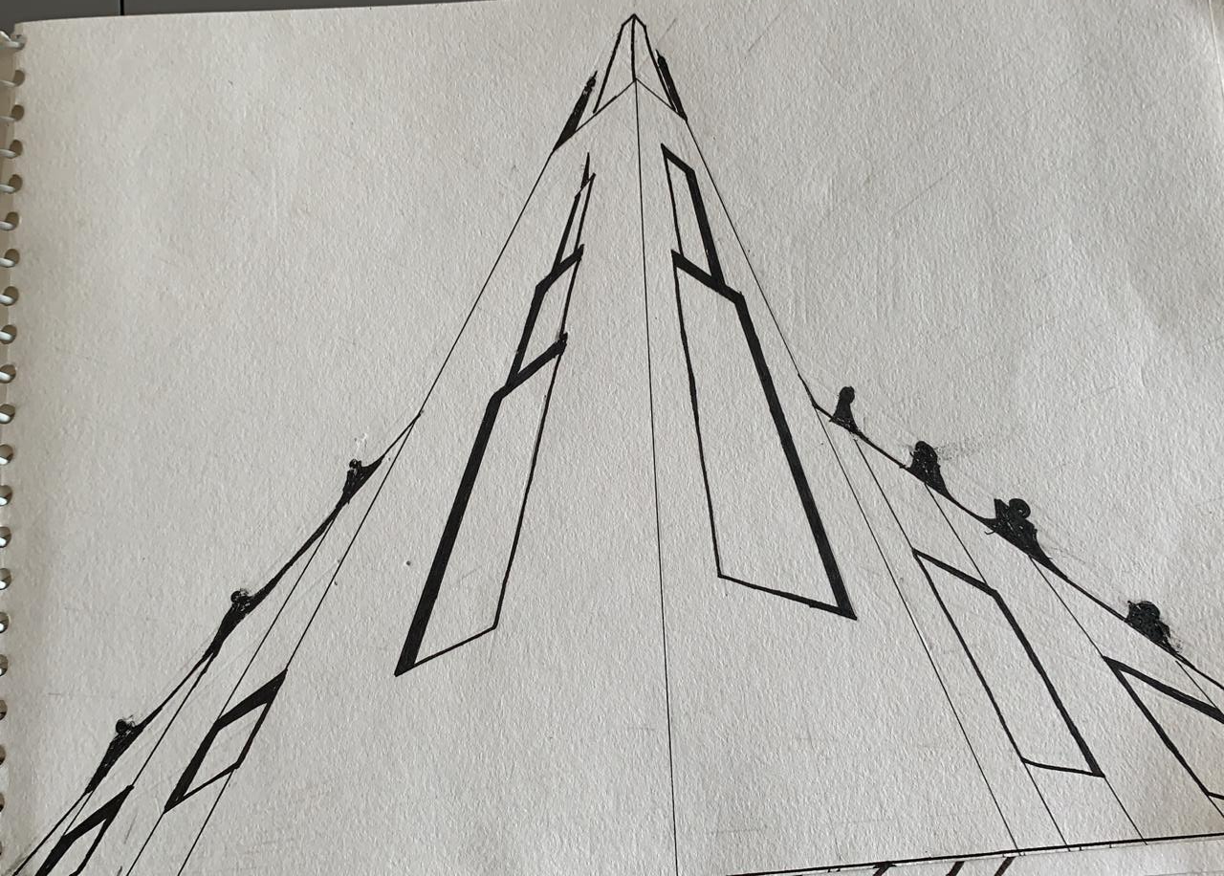
FENA MAHESHWARI

Slide 18
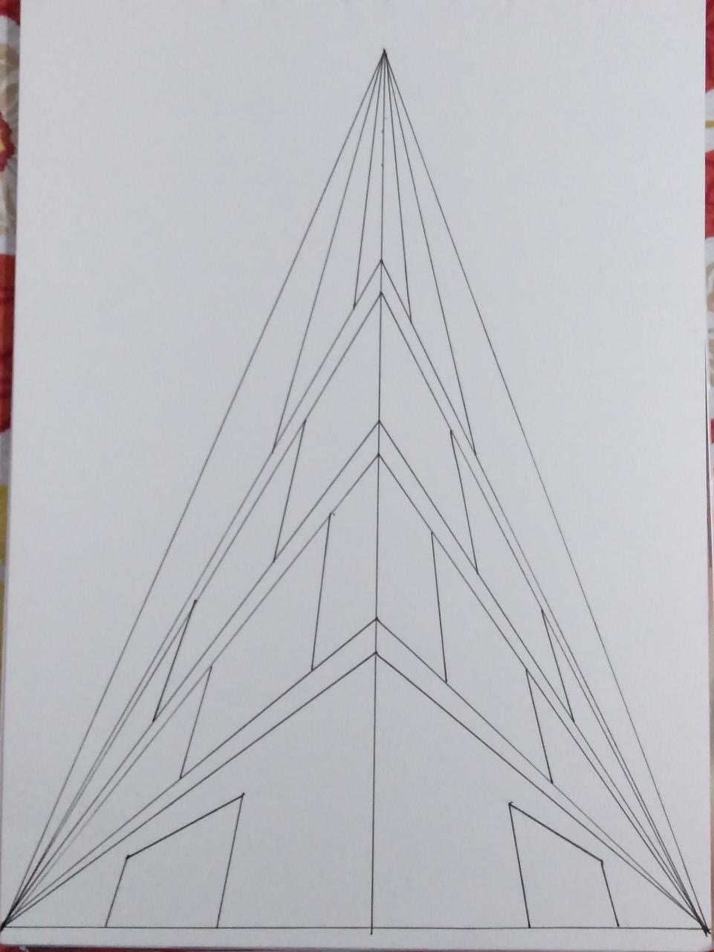
HARSH PATEL

Slide 19
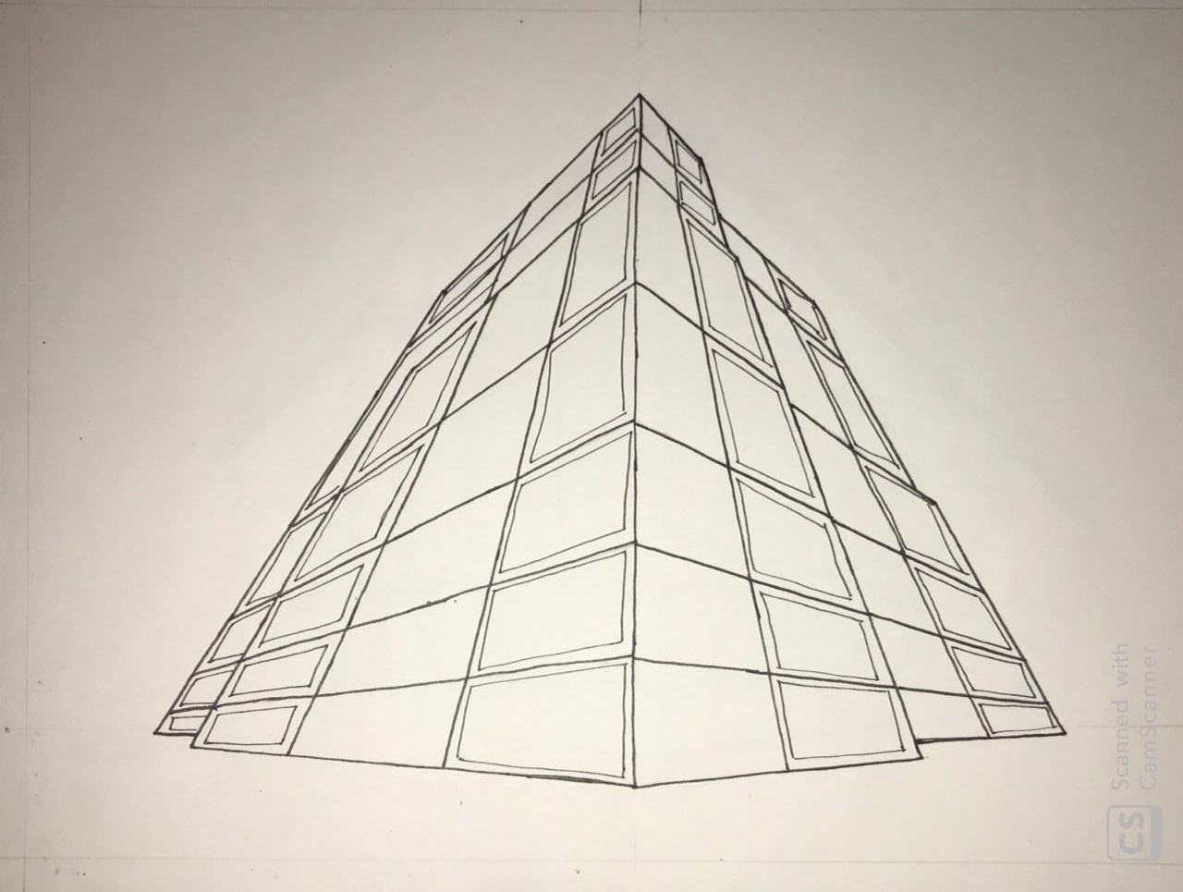
KHUSHI GALA

Slide 20
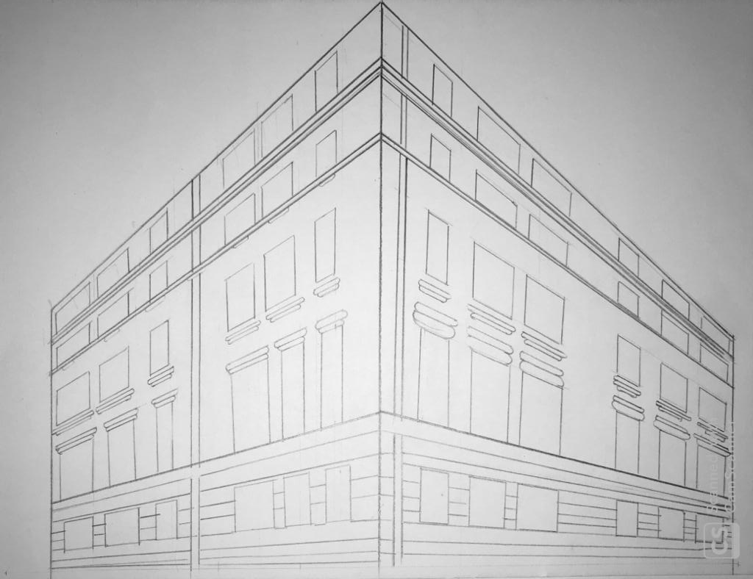
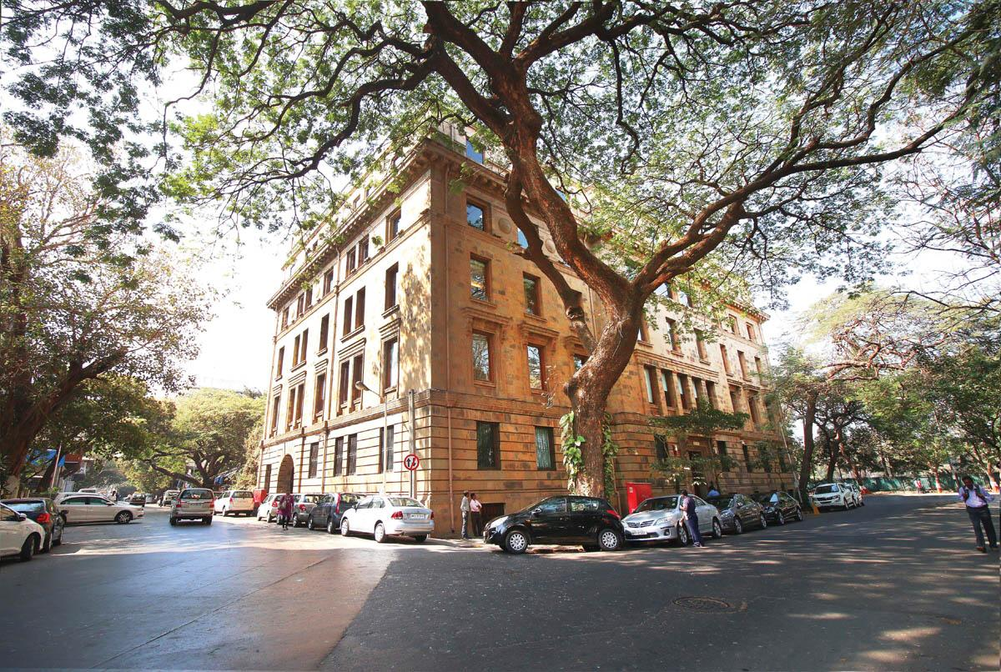
RASILA BERA

Slide 21
FISH EYE VIEW

Slide 22
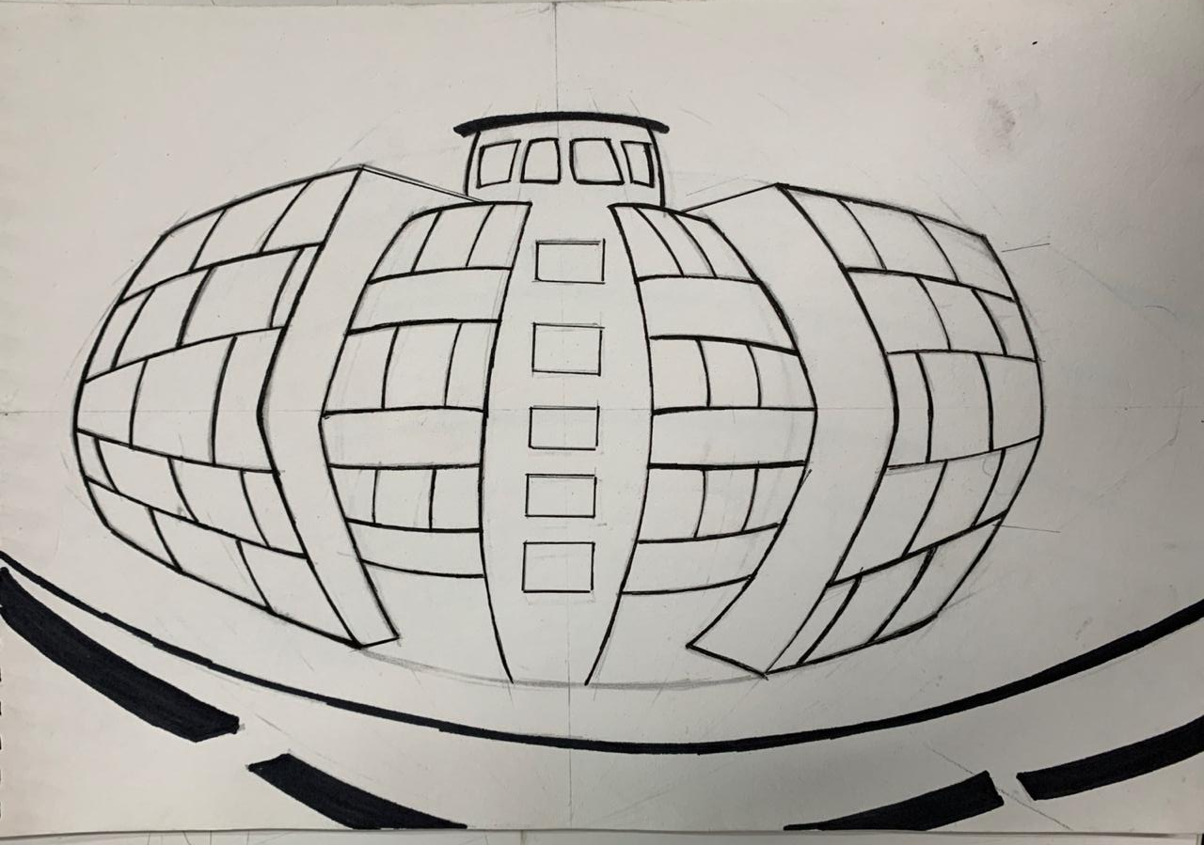
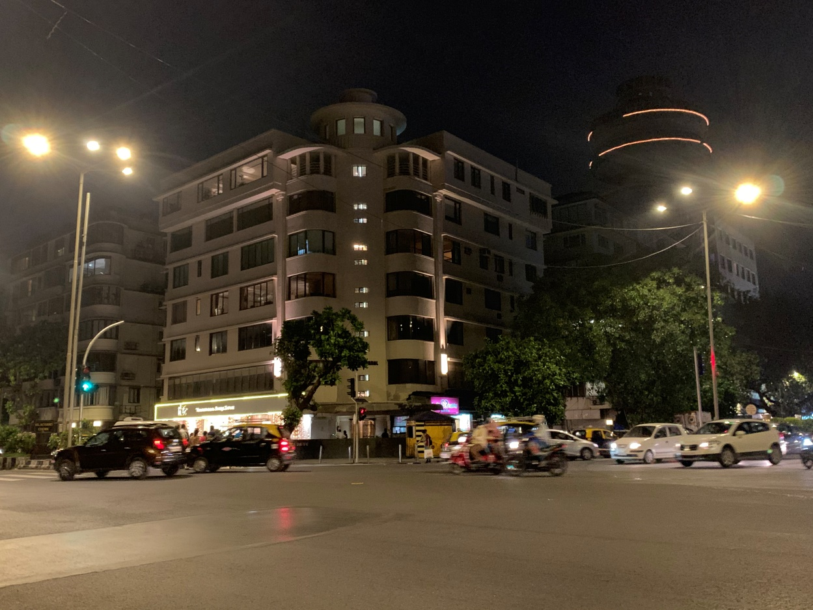
DIPANNITA CHOWDHURY

Slide 23
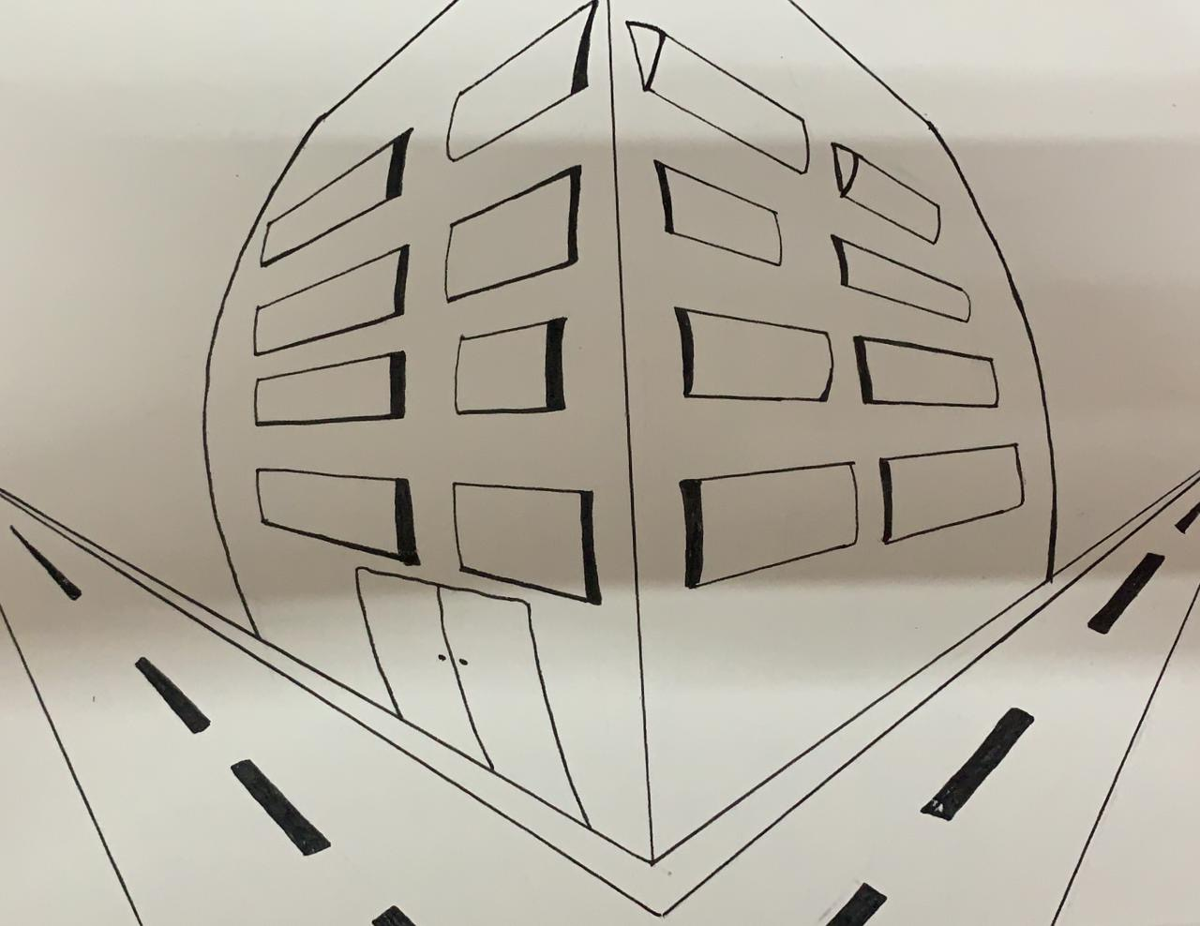
FENA MAHESHWARI

Slide 24
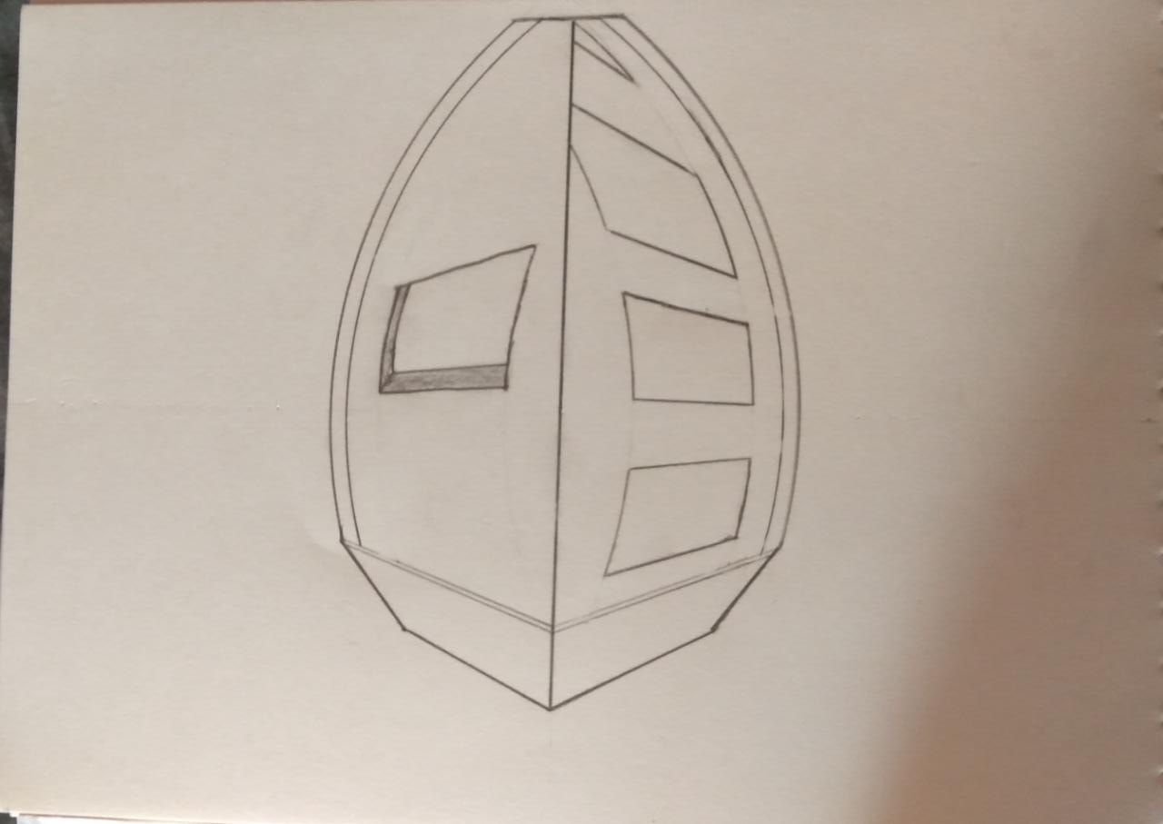
HARSH PATEL

Slide 25
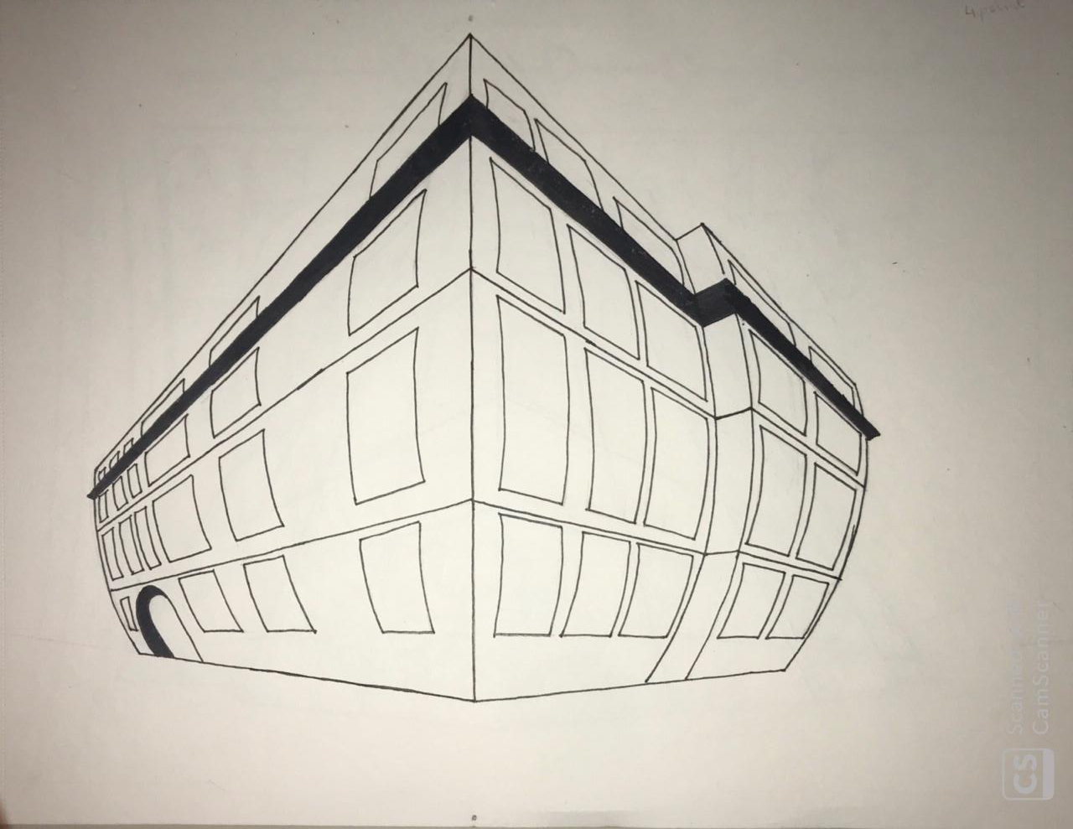
KHUSHI GALA

Slide 26
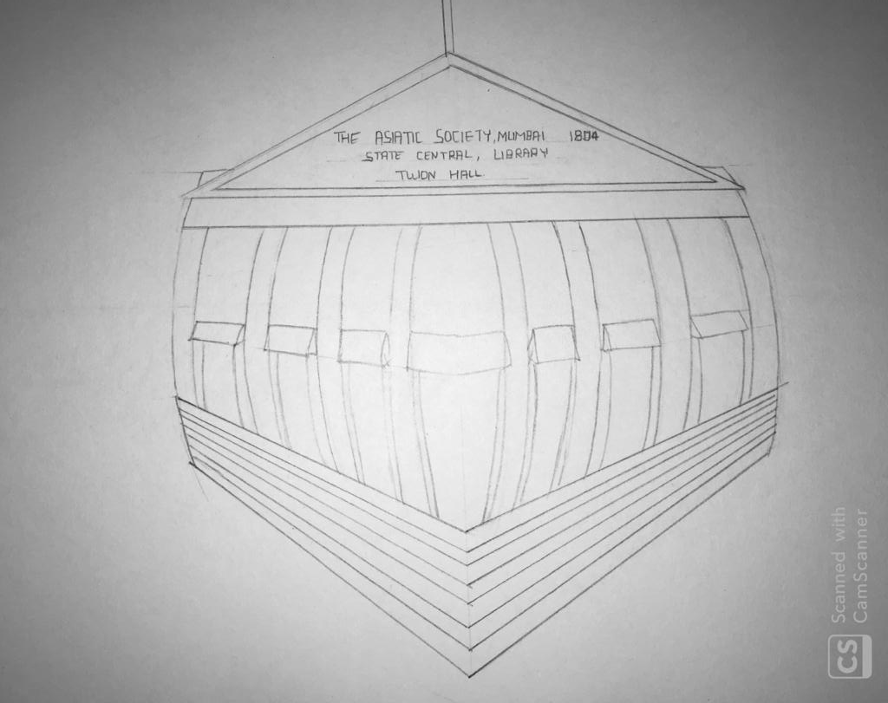
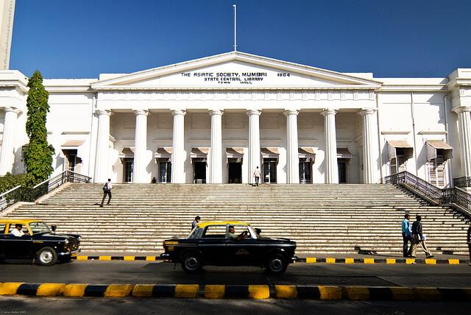
RASILA BERA

Slide 27
BIRD’S EYE VIEW

Slide 28
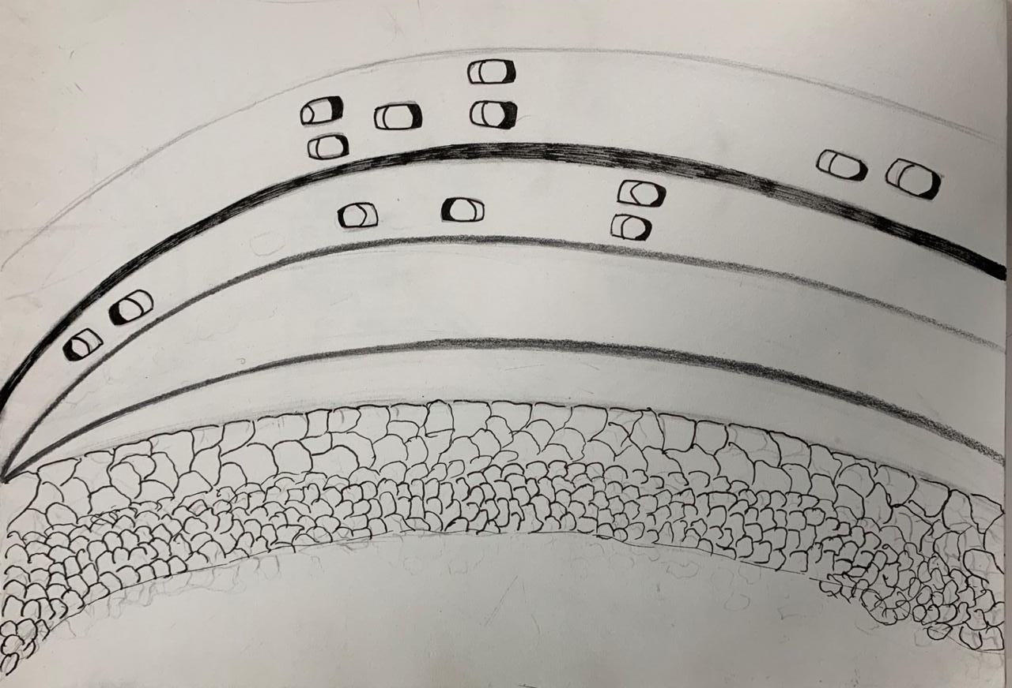
DIPANNITA CHOWDHURY

Slide 29
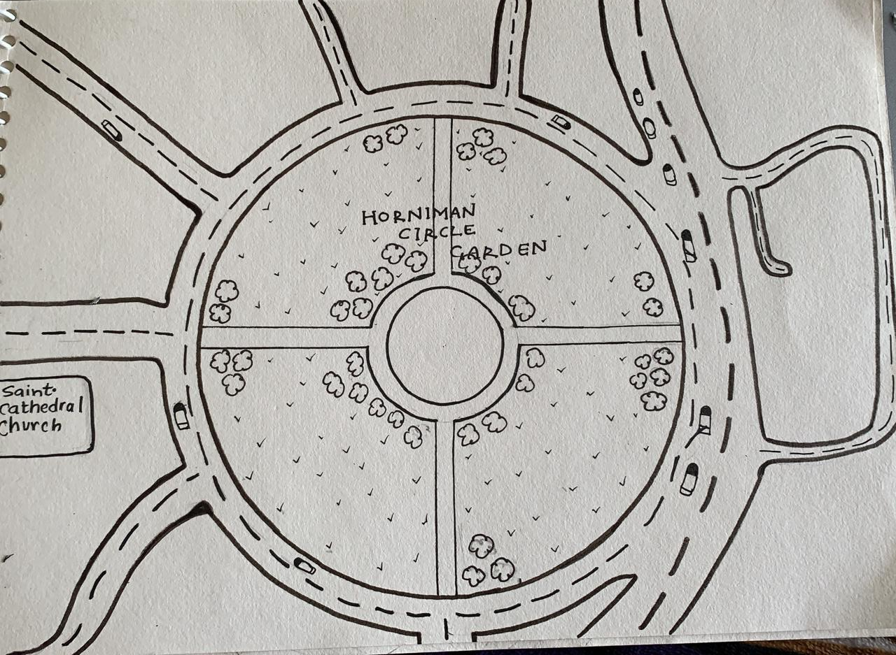
FENA MAHESHWARI

Slide 30
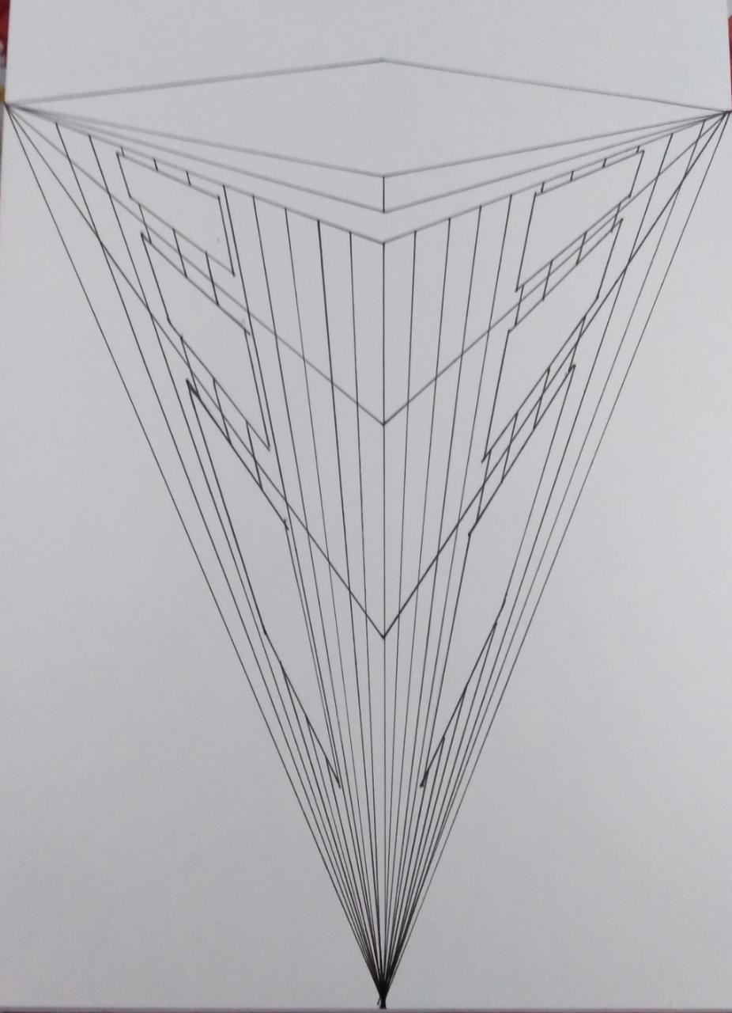
HARSH PATEL

Slide 31
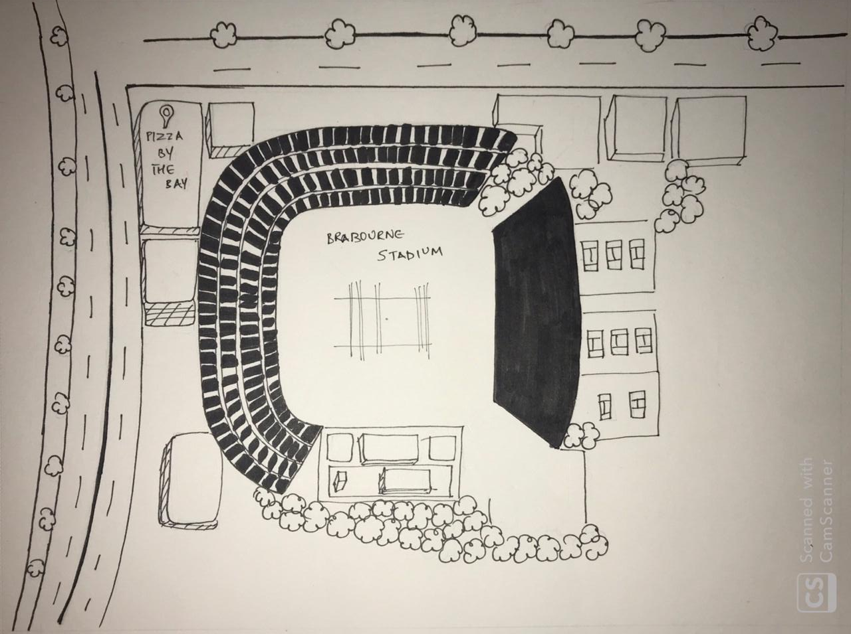
KHUSHI GALA

Slide 32
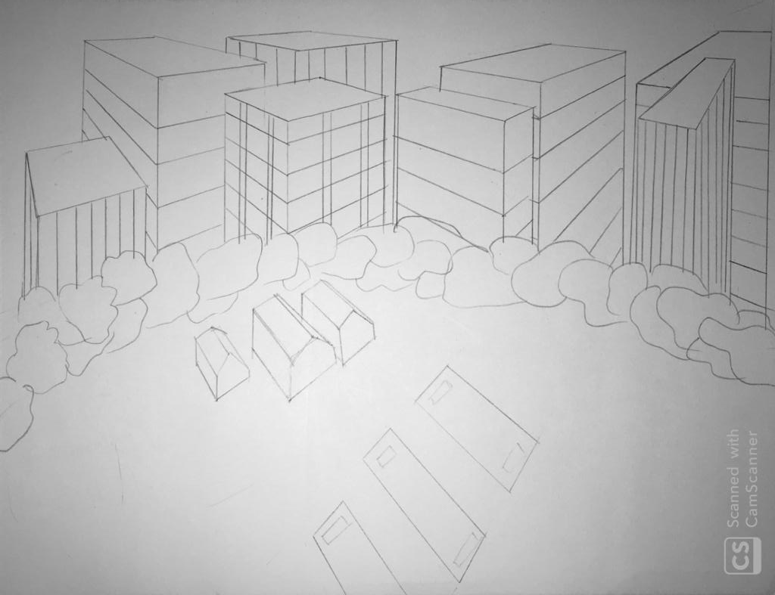
RASILA BERA

Slide 33
MAPS

Slide 34
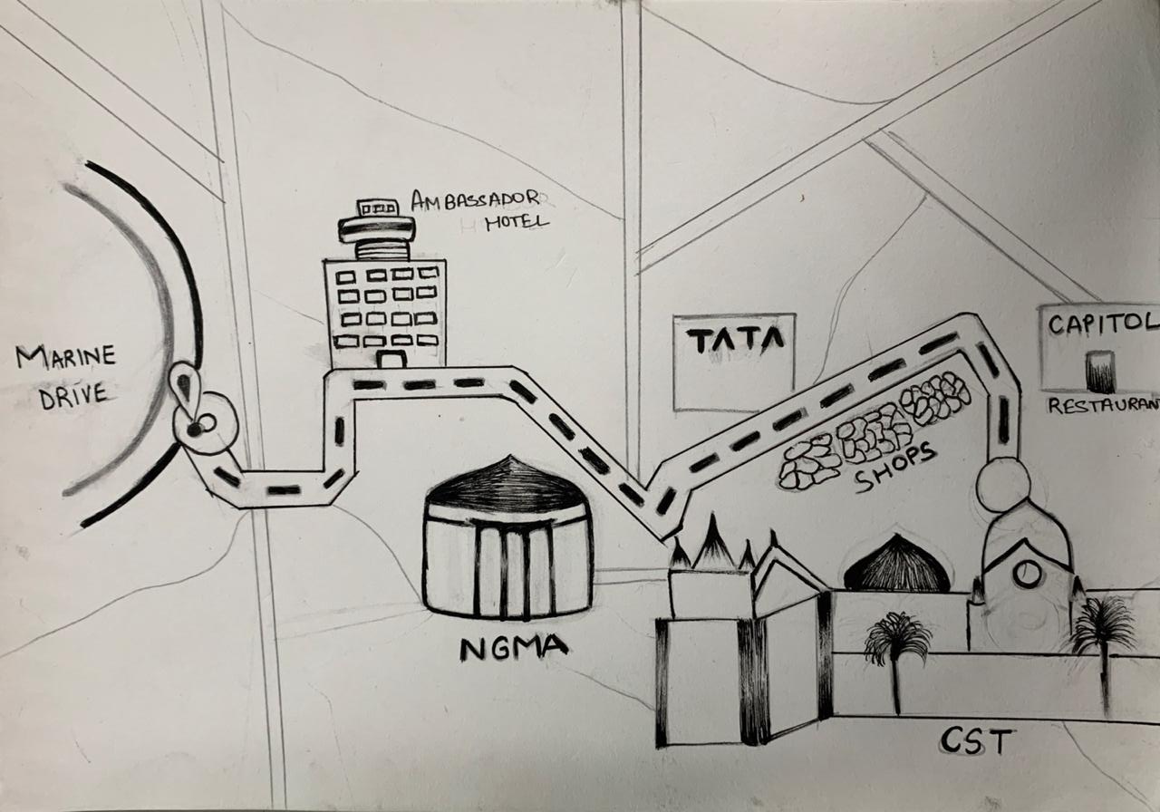
DIPANNITA CHOWDHURY

Slide 35
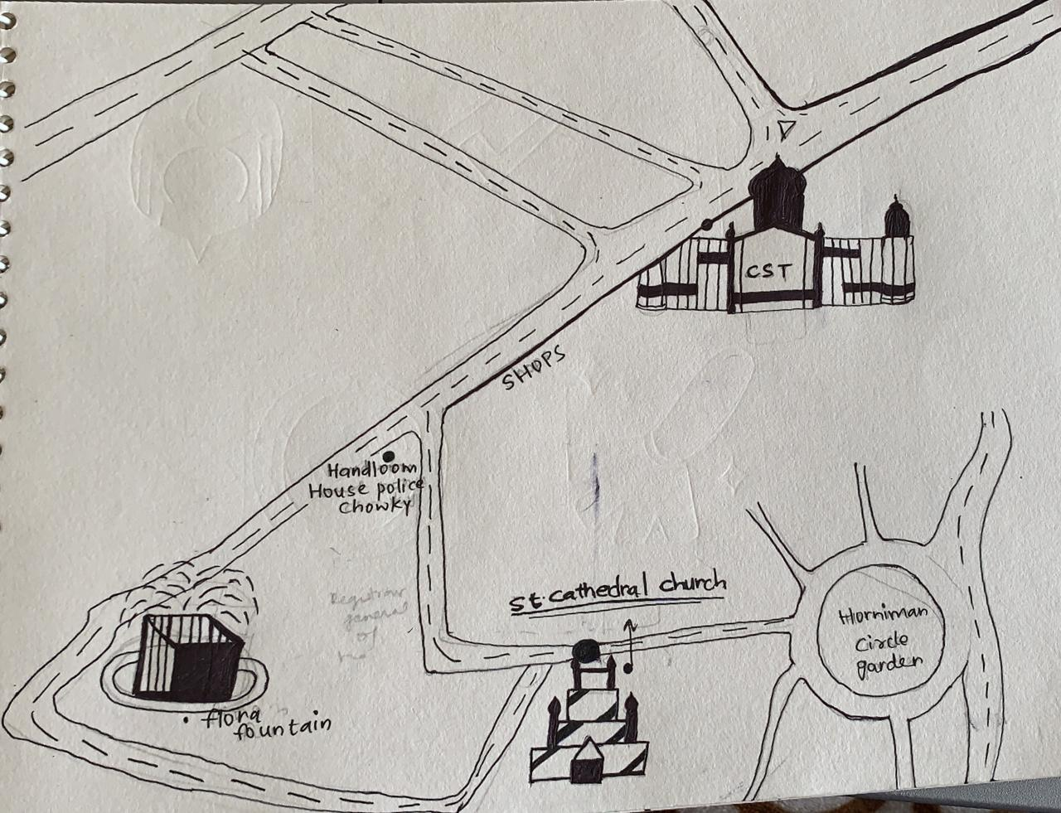
FENA MAHESHWARI

Slide 36
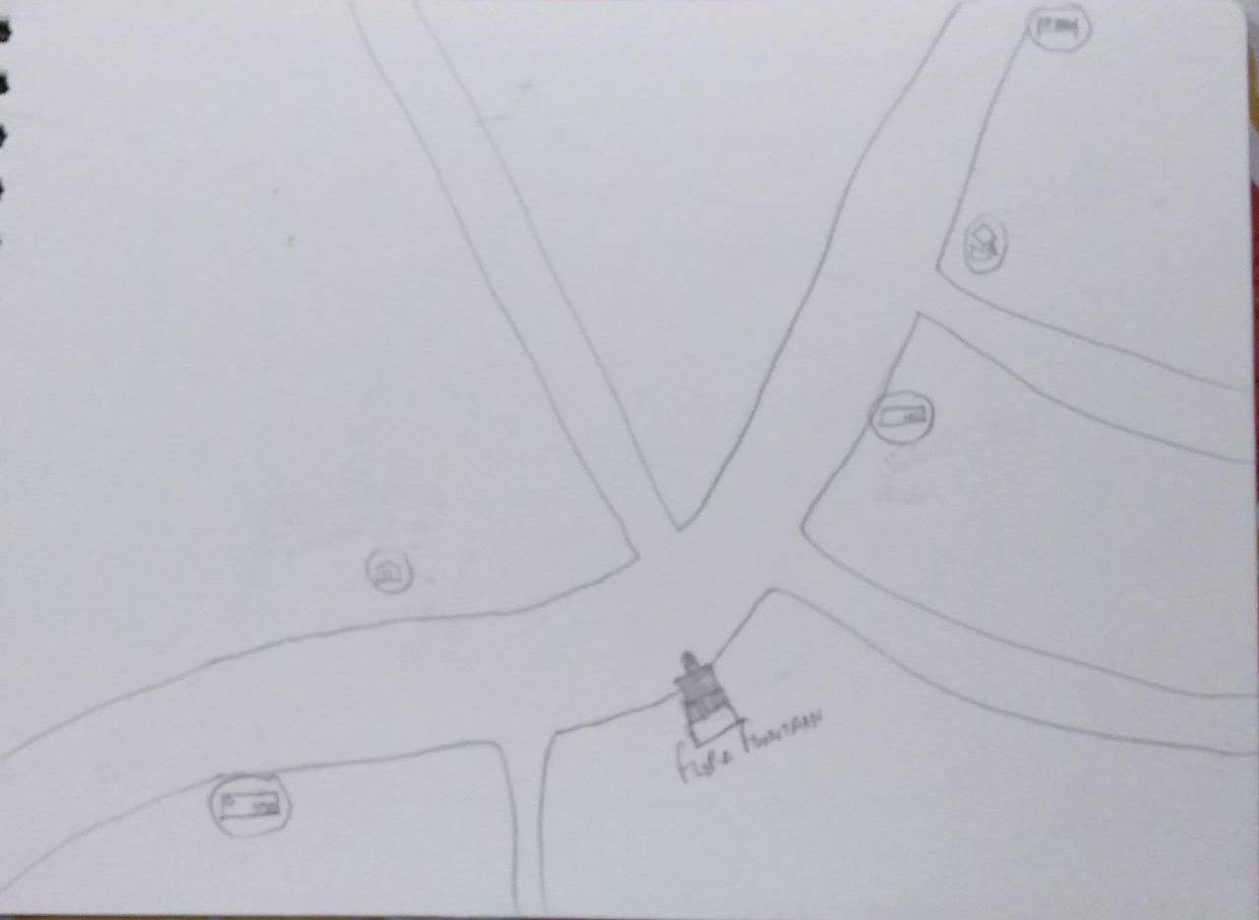
HARSH PATEL

Slide 37
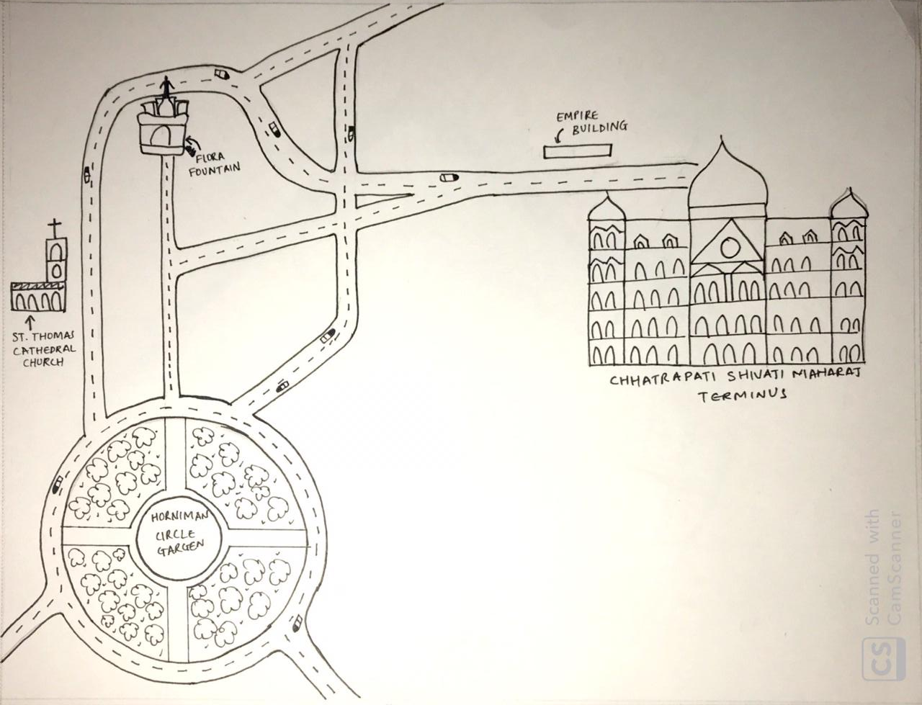
KHUSHI GALA

Slide 38
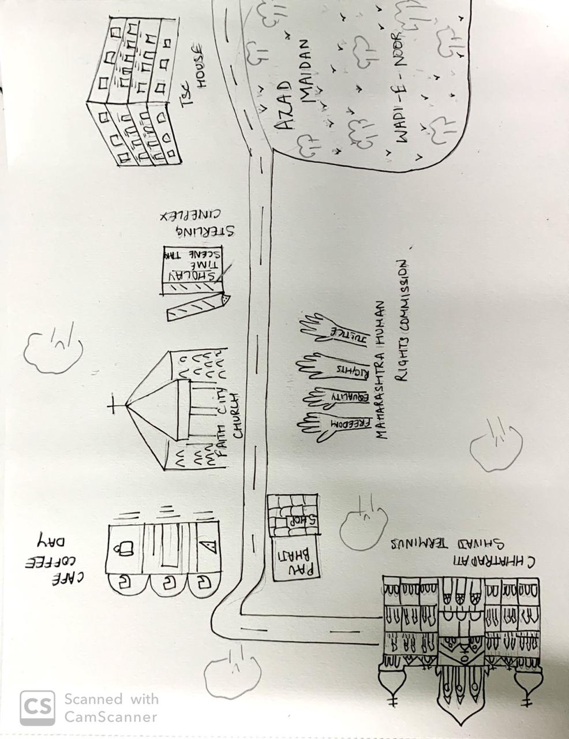
RASILA BERA

Slide 39
PICTURES OF THE AREA

Slide 40
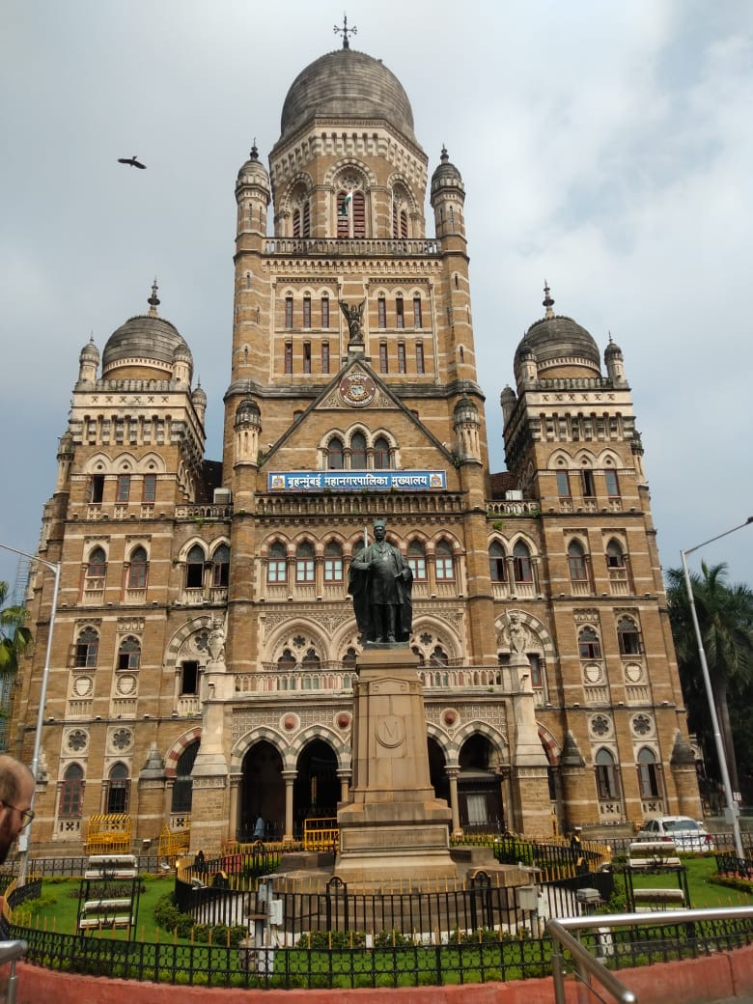
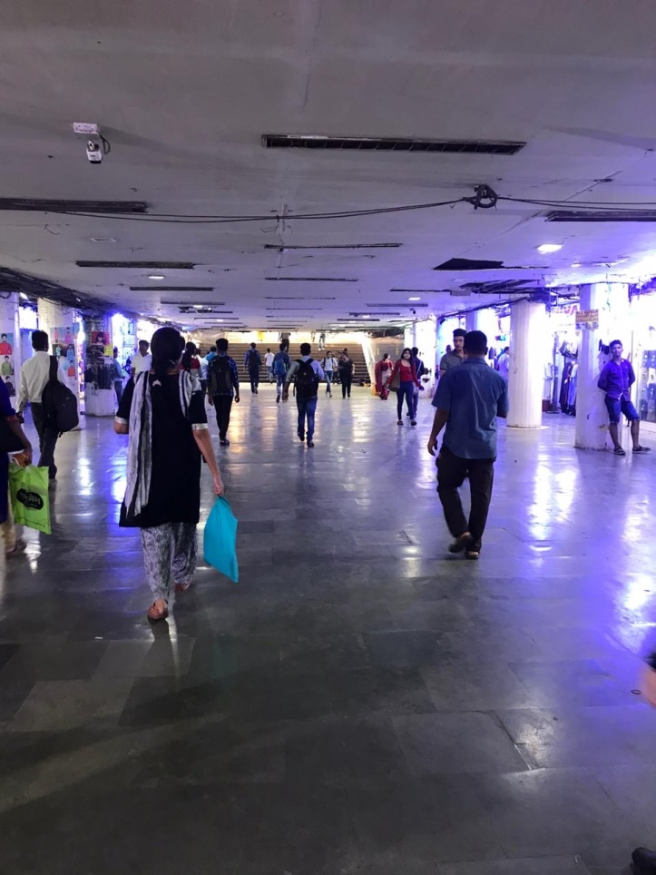
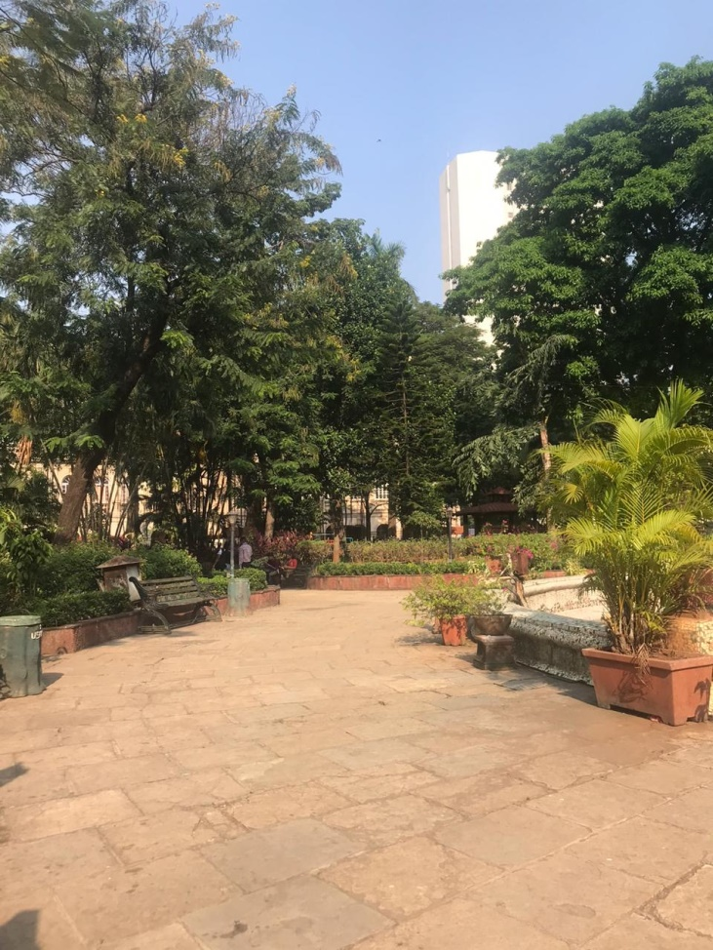

Slide 41
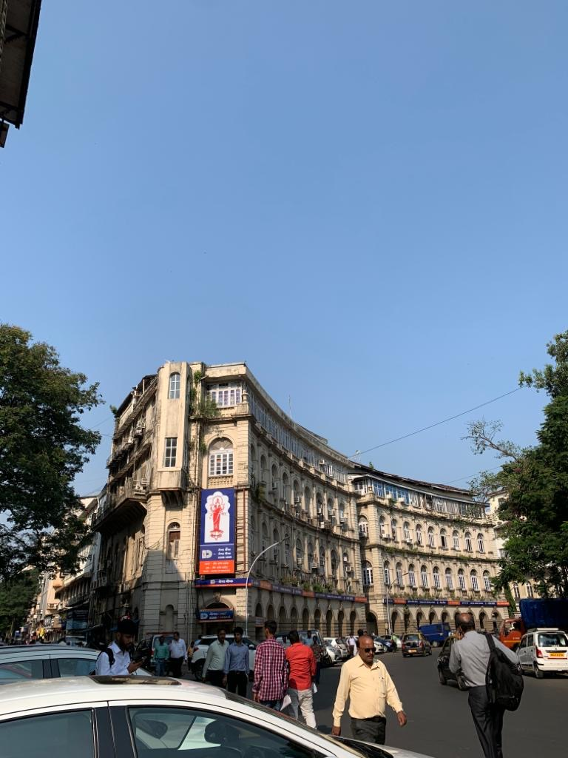
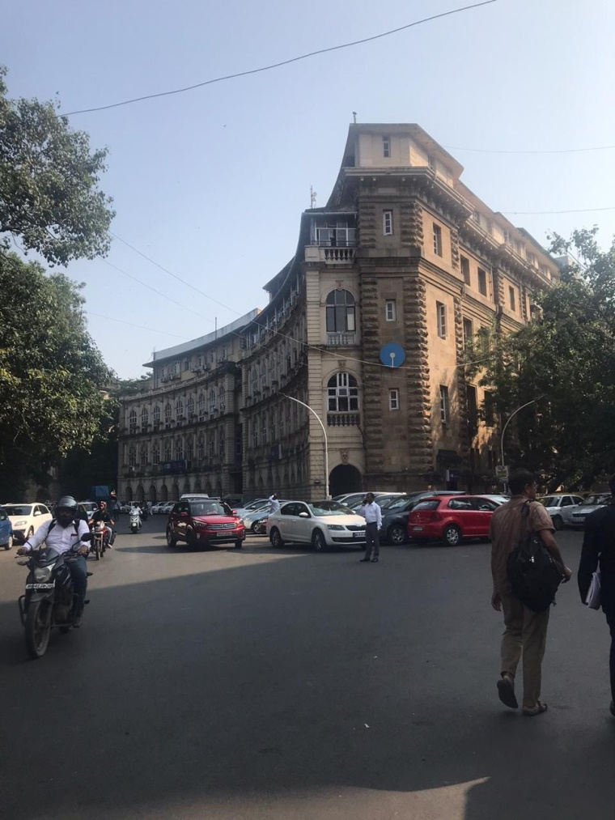

Slide 42
