Slide 1
ANIMAL CRUELTY
TANUSHREE HIMMATRAMKA
RASILA BERA
PRIYANKA SHEWANI
AKSHATA SUKHTANKAR
TRISHI JAIN
FYS-F

Slide 2
Aim and introduction
Our aim is to spread awareness about Animal cruelty to kids aged 10-15 years, in the form of a game .
What is Animal Cruelty?
Putting animals through an emotional or physical phase that involves harming them in anyway, which can be considered morally wrong from a general perspective
It Can be classified into active or passive abuse
It has Different forms, namely: Unethical factory farming, illegal animal festivals, entertainment industry, zoos, hunting, experimentation and testing, fur trading an the list continues.

Slide 3
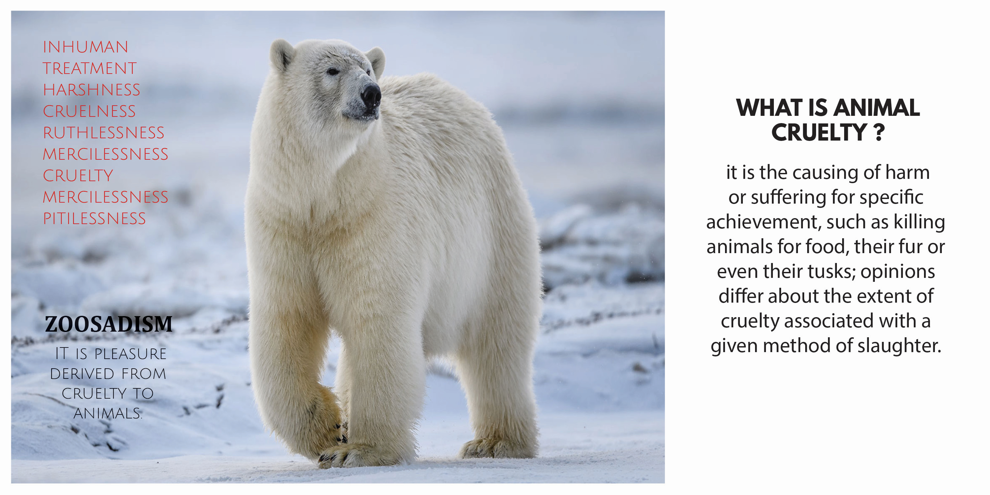
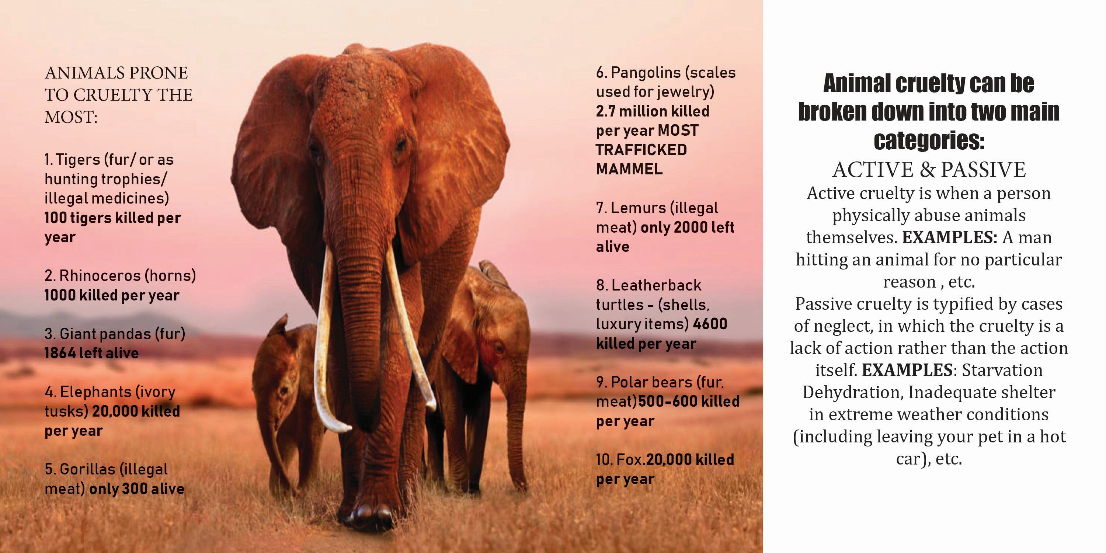

Slide 4
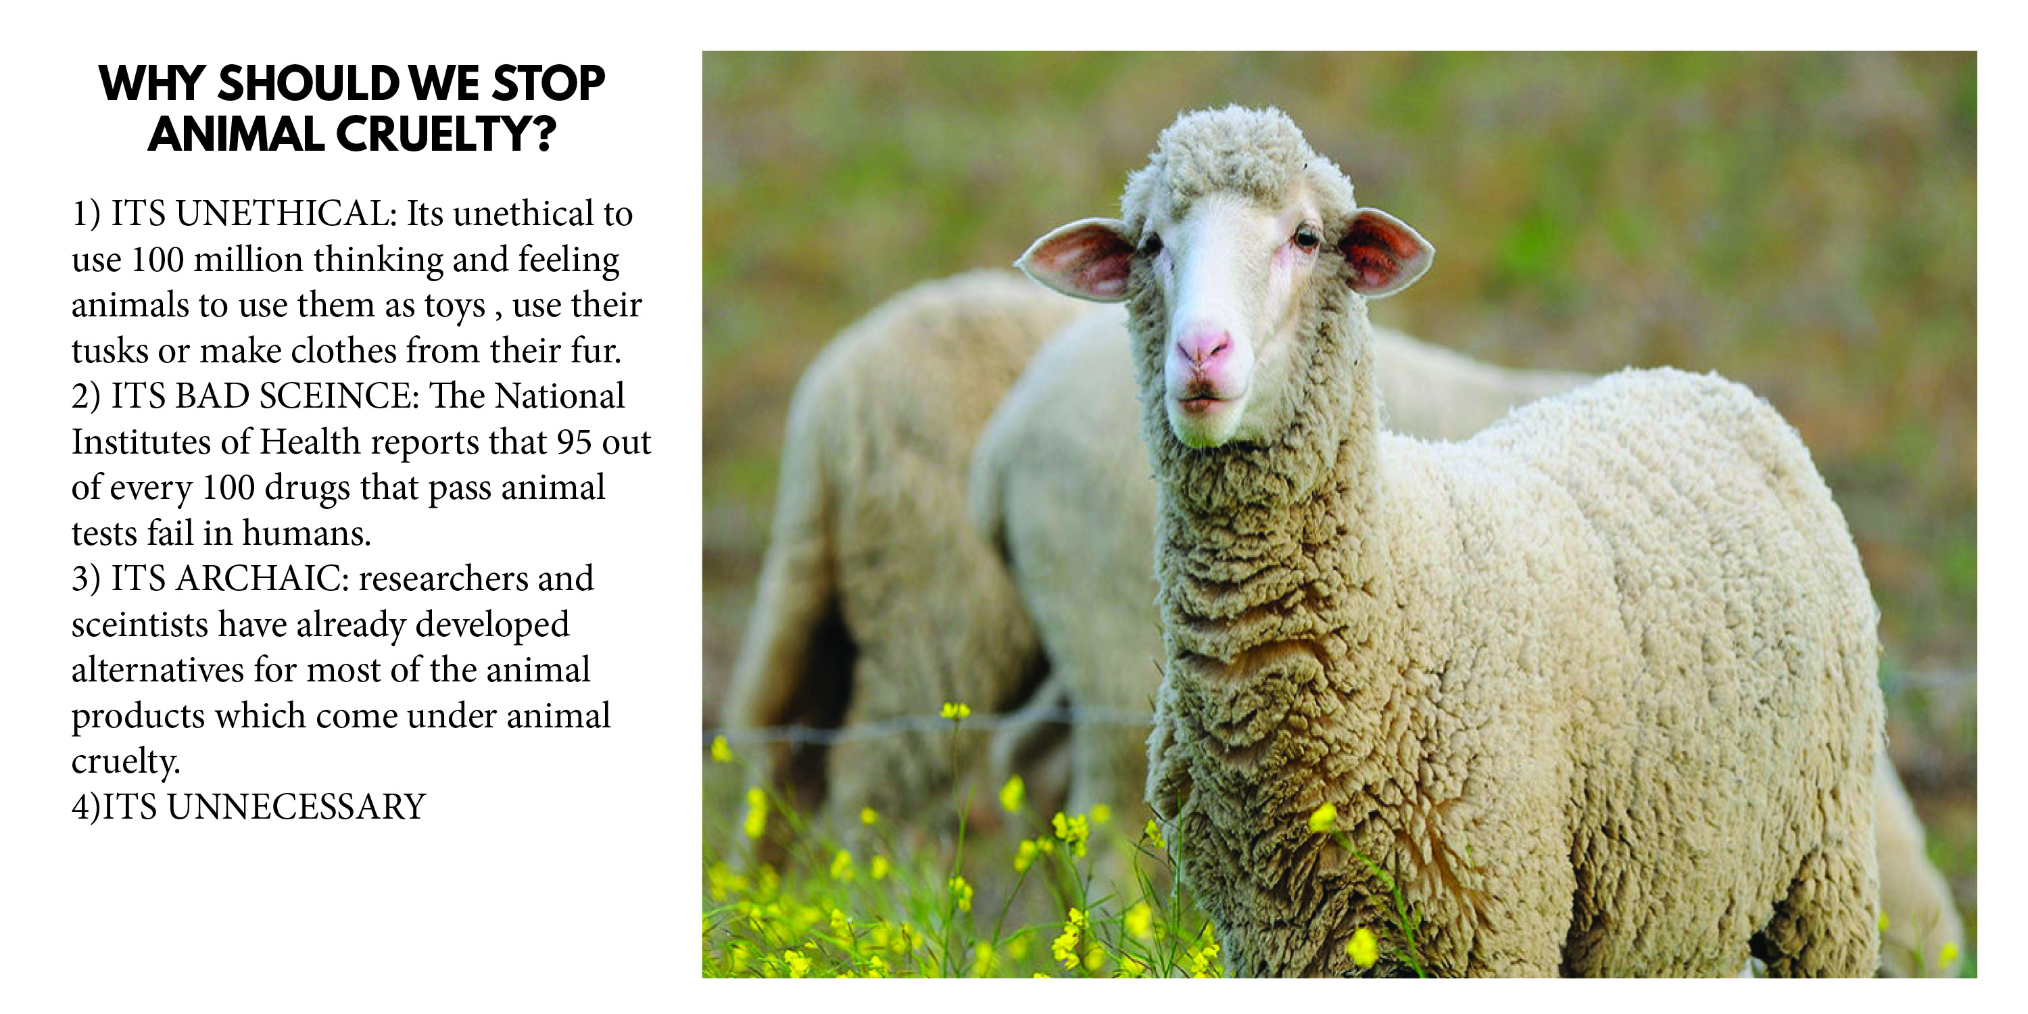

Slide 5
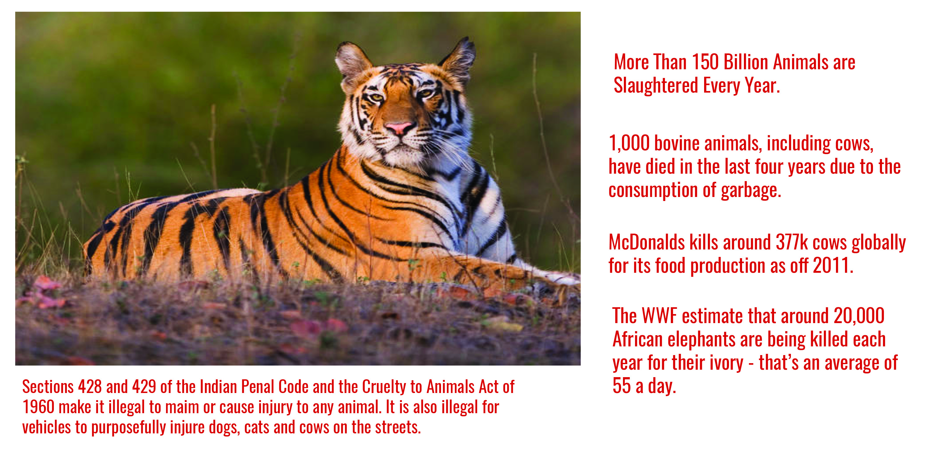

Slide 6
Game 1
the game would consist of 2 parts and the number of people can be 4-6 in pairs
first part : it would be a rapid fire quiz round, this would be intra pair, held between 2 people and both would face each other, while any one of the other pair would judge them.
Both the people would have cards in their hands in which questions related animal cruelty would be written, the scale would be basic to tough and the answer key would be with the person whose judging
first 10 questions who ever gets it right moves to the second round . So like if there are 6 people then 3 go to the next round .
Second part - this would be a jigsaw puzzle thing and whoever solves it first wins .
The first part would not only be informative but also would have a sense of competitiveness. We can also have the cards shaped in animal silhouettes as well to make it more appealing.
There would also be various question sets so that the the same questions don’t get repeated again and again .

Slide 7
GAME 2 ( finalised one)
This is a team cards game of 2 or more players where in there would be two piles namely : Letter card pile and action card pile.
The letter card pile has cards with one letter written on it and the action card had different questions written on it related to animal cruelty .
During one’s chance , he/she has to pick up an action card and answer it in one word with the word starting from the letter card’s letter .
The one who finishes with his cards first is the winner .
To make the game more interesting , we can add some wild cards like extra turn, big switch ,etc to keep the children engrossed.
There would also be trading coins inspired from animals .
So whoever answers a correct question card then he/she would get a coin and once the coins are finished from the bank then the players start trading the coins from one another
Whoever has most of the coins wins the game .

Slide 8
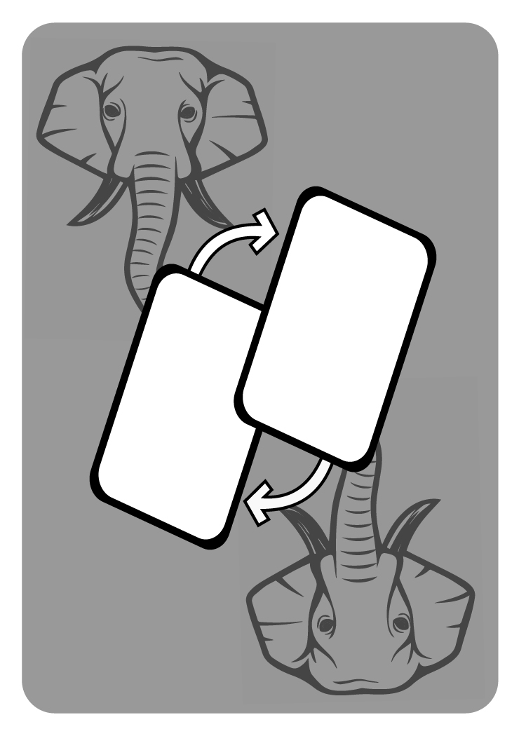

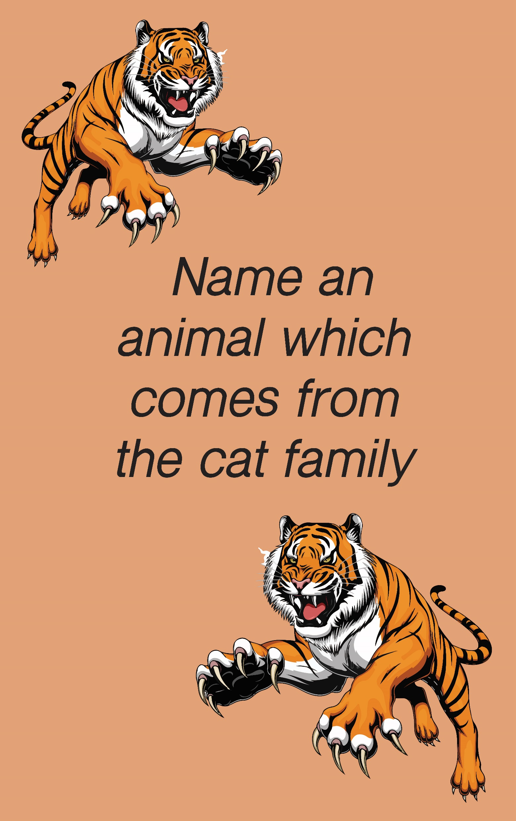






CARD INTERFACE
ACTION CARDS
QUESTION CARDS
LETTER CARDS

Slide 9
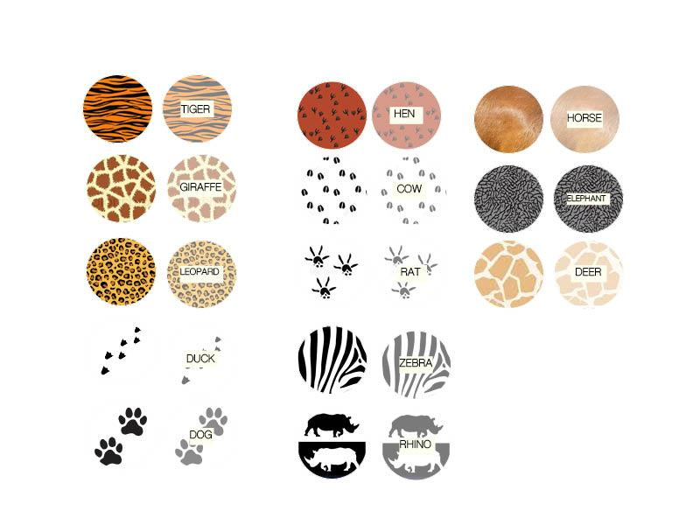
COINS

Slide 10
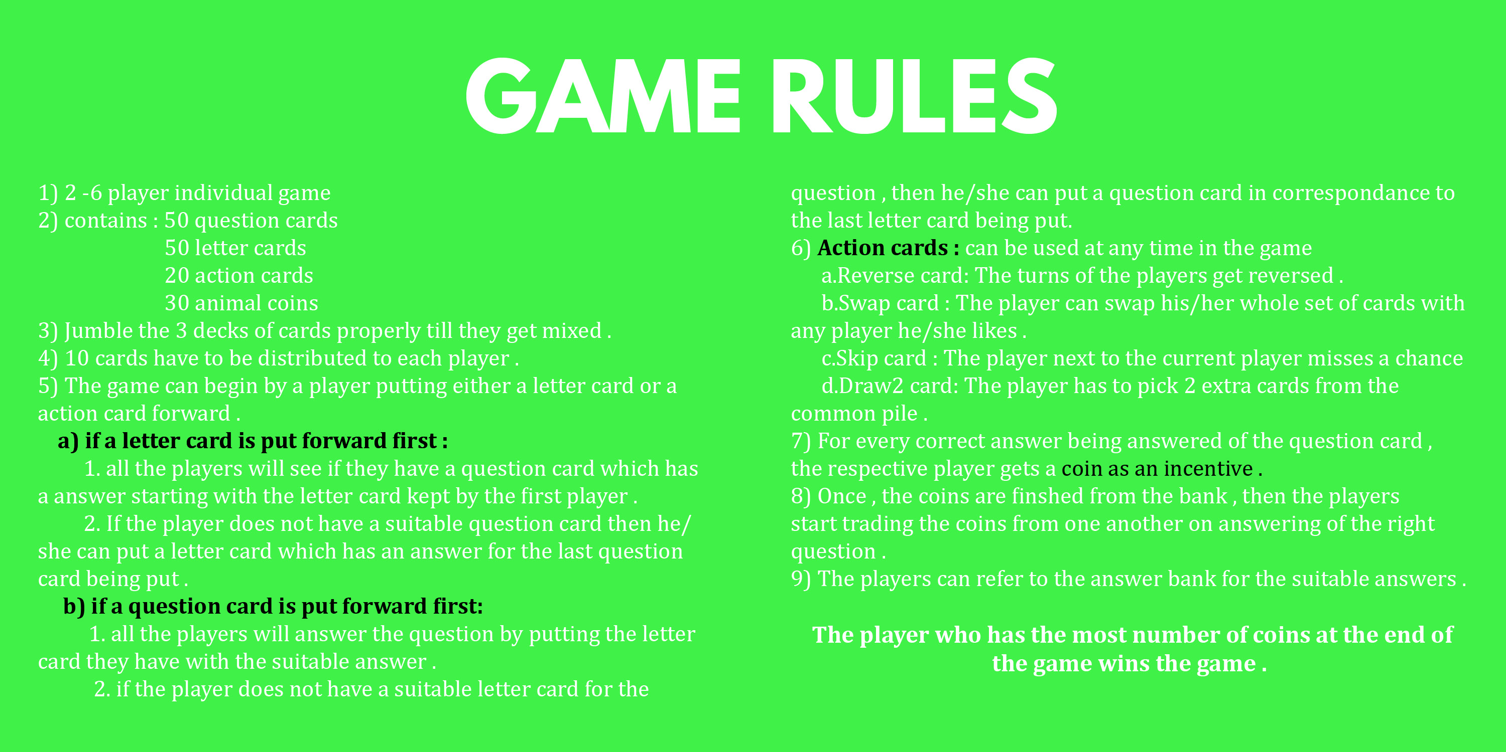
GAME RULES

Slide 11
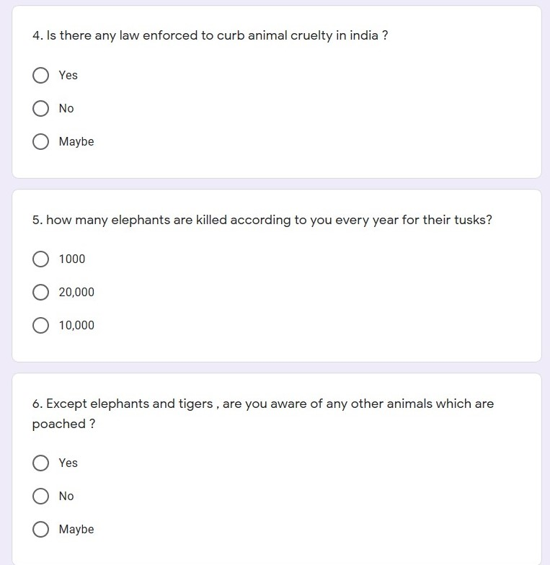
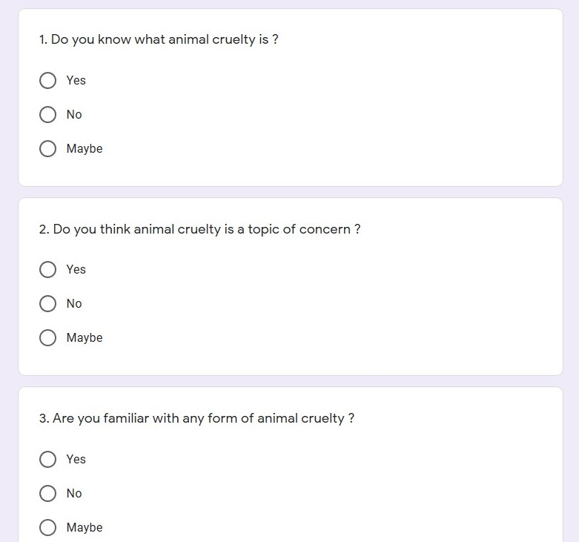
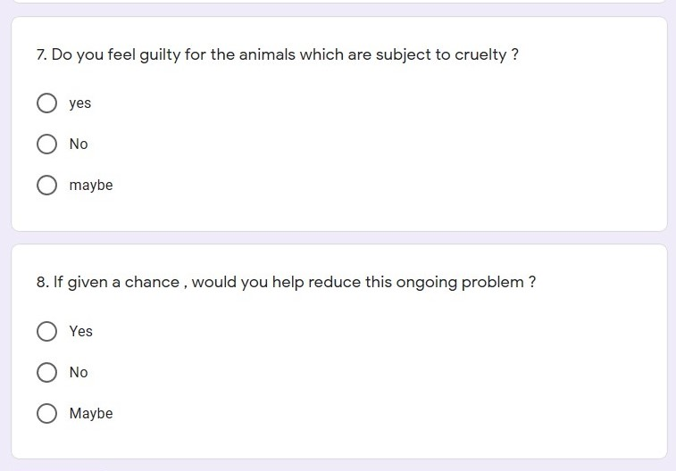
SURVEY

